Slide 1
System Analysis and Design
CSUB
Yong Choi

Slide 2
Systems Analysis Phases
Scope Definition Phase : WHAT PROBLEM
Is the project worth looking at ?
Problem Analysis Phase: WHAT ISSUES
Is the new system worth building?
Requirements Analysis Phase: WHAT REQUIREMENTS
What do stakeholders need and want from the new system?
Logical Design Phase: WHAT TO DO
What the new system must do.
Decision Analysis Phase: WHAT SOLUTION
What is the best available solution ?

Slide 3
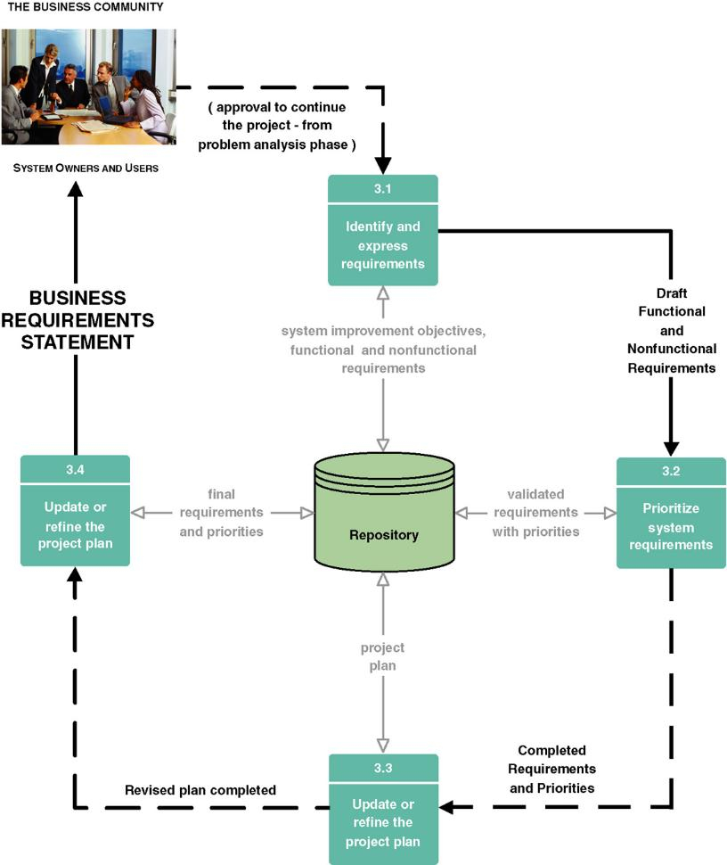
Requirements Analysis Tasks

Slide 4
Requirements Discovery
The process and technique that business analyst and developer use to identify, analyze, and understand system requirements.
systems requirements specify what the information system must do, or what property or quality the system must have.
Notes:
No additional notes.

Slide 5
Results of Incorrect Requirements
The system may cost more than projected.
The system may be delivered later than promised.
The system may not meet the stakeholders’ expectations and that dissatisfaction may cause them not to use it.
Once in production, the costs of maintaining and enhancing the system may be excessively high.
Commercial Application Packages
The system may be unreliable and prone to errors and downtime.
Notes:
No additional notes.

Slide 6
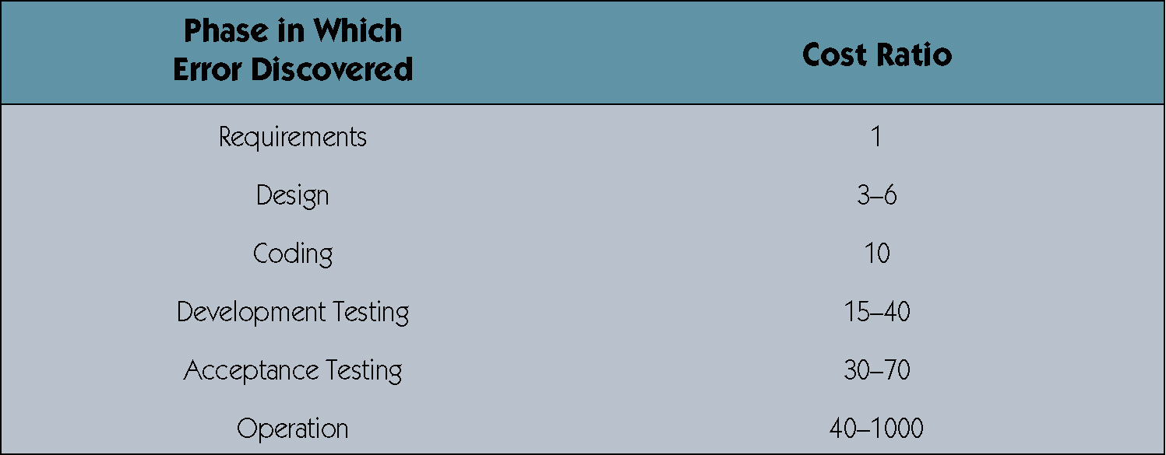
Relative Cost to Fix an Error

Slide 7
New Denver airport
Twice the size of Manhattan, NY
10 times wider than London airport
Big enough to land three jets simultaneously-in bad weather
Baggage-handling information system
One of kind…
Started September of 1989
Expensive: $1.7 billion (original price)
Very large size….
The most advanced and sophisticated automated baggage handling system

Slide 8
Scale of baggage-handling system
21 miles of steel track
Tearing like intelligent coal-mine cars
4,000 independent "telecars" route and deliver luggage between the counters, gates and claim areas of 20 different airlines.
Size of the system
100 computers are networked to one another and to 5,000 electric eyes
400 radio receivers
56 bar-code scanners orchestrates the safe and timely arrival of every valise and ski bag.

Slide 9
Result
Scheduled to open Nov, 94
Delayed nine-month because of system glitches.
Original price $1.7 billion, final cost $4.8 billion
Their bond rating demoted to junk and their budget hemorrhaging red ink at the rate of $1.1 million a day in interest and operating costs.

Slide 10
The Process of Requirements Discovery
Problem discovery and analysis
Requirements discovery
Documenting and analyzing requirements
Requirements management to handle changes

Slide 11
Analyzing Requirements
Analyzing requirements to resolve problems of:
Missing requirements
Conflicting requirements
Infeasible requirements
Overlapping requirements
Ambiguous requirements
Formalizing requirements
Requirements definition document
Communicated to stakeholders or steering body
Notes:
No additional notes.

Slide 12
Fact-Finding Technique
** ..is used for across the entire development cycle, but extremely critical in the requirements analysis phase..**
Seven common techniques
Sampling of existing documentation, forms, and databases.
Research and site visits.
Observation of the work environment.
Questionnaires.
Interviews.
Prototyping.
Joint requirements planning (JRP).

Slide 13
System Development Process
Systems development process:
a set of activities, methods, best practices, deliverables, and automated tools that stakeholders use to develop and continuously improve information systems and software .
Using a standardized framework:
Create efficiencies that allow management to shift resources between projects
Produces consistent documentation that reduces lifetime costs to maintain the systems
Promotes quality: All US Gov. systems development requires certain quality management requirements such as CMM model.

Slide 14
The Capability Maturity Model
Capability Maturity Model (CMM) – a standardized framework for assessing the maturity level of an organization’s information system development and management processes.
Highly recognized and famous model
Developed by The Software Engineering Institute (SEI)
Is being used to qualify IS developers for US federal Gov. projects.
CMM consists of five levels of maturity.
Each level is a prerequisite for the next level.
Notes:
Conversion Notes
CMM was not covered in our competition at the time we wrote this material. We feel that it is very important. CMM is the information technology response to the total quality management initiative. CMM breathed new life into the importance of a system development process. The term “process” in CMM is equivalent to the term “methodology” as popularized in systems analysis and design methods.
Teaching Notes
Recognize that each level is a prerequisite for the next level.
Most organizations pursuing the CMM are targeting Level 3, that is, consistently using a standardized process or methodology to develop all systems.
CMM Level 2 deals with project management. CMM Level 3 deals with what has come to be known as process management.

Slide 15
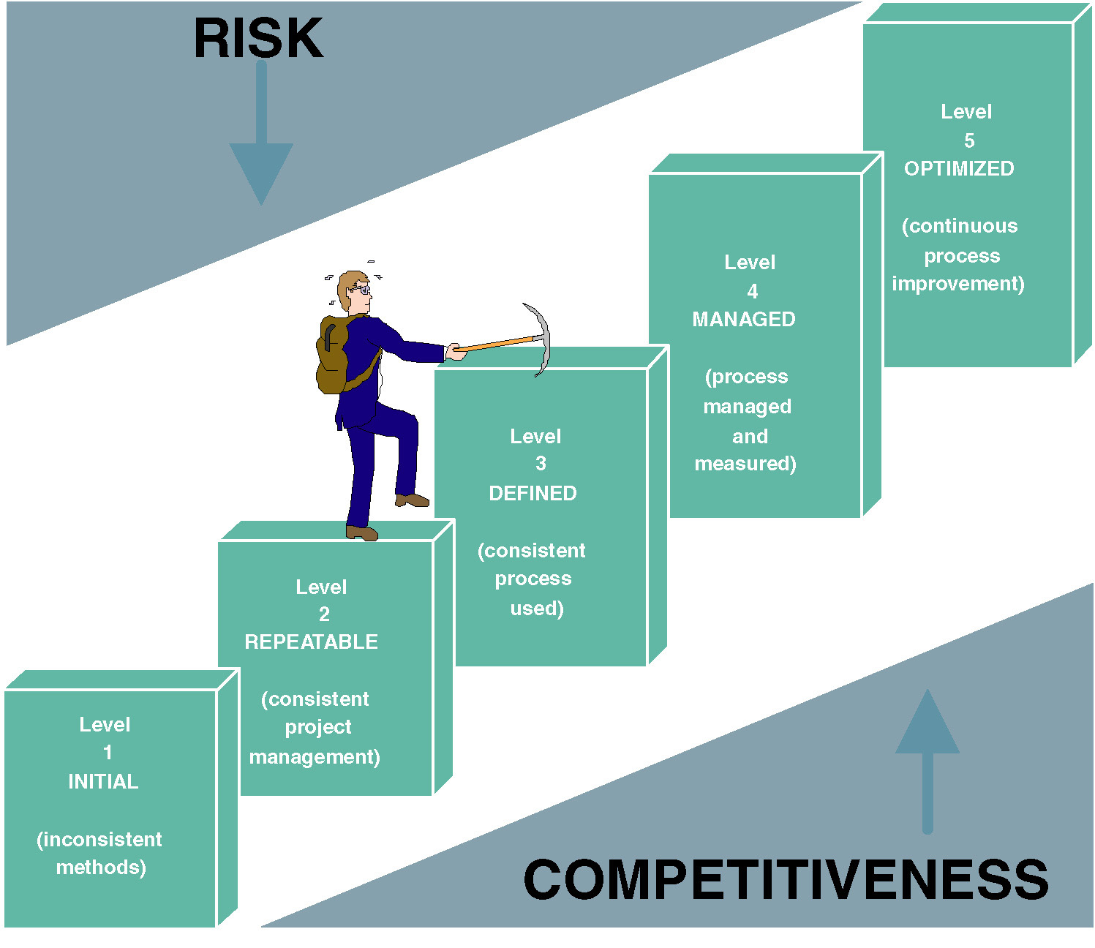
Notes:
No additional notes

Slide 16
The CMM Process Management Model (con’t)
Level 1—Initial: System development projects follow no prescribed process.
Level 2—Repeatable: Project management processes and practices are established to track project costs, schedules, and functionality.
Level 3—Defined: A standard system development process (sometimes called a “methodology”) is developed. All projects use a version of this process to develop and maintain information systems and software.
Level 4—Managed: Measurable goals for quality and productivity are established (some IT companies are getting closer……)
Level 5—Optimizing: The standardized system development process is continuously monitored and improved based on measures and data analysis established in Level 4.

Slide 17
Impact of System Development “Process” on Quality
CMM Project Statistics for a Project Resulting in 200,000 Lines of Code
Organization’s CMM Level | Project Duration (months) | Project Person-Months | Number of Defects Shipped | Median Cost ($ millions) | Lowest Cost ($ millions) | Highest Cost ($ millions)
1 | 30 | 600 | 61 | 5.5 | 1.8 | 100+
2 | 18.5 | 143 | 12 | 1.3 | .96 | 1.7
3 | 15 | 80 | 7 | .728 | .518 | .933
Significant improvements in terms of schedule and cost at level 3
Thus, most organizations pursuing the CMM are targeting level 3.
Notes:
Conversion Notes
This table was in the 5th edition text but not in the 5th edition PowerPoints.
Teaching Notes
This table dramatically illustrates the value of following a methodology. Note the drop in project duration, person-months, defects, and costs as a result of following a consistent methodology

Slide 18
More about CMM model
Implications
You CANNOT skip level
It takes time to move from one level to the next
Not many organization are above level 1
Highly difficult to start at the level 3
Esoteric new technology should be avoided at the lower levels (especially level 1 and 2)
Starting level for the off-the-shelf systems
The levels are already becoming important for contracts.

Slide 19
Basic principle's of System Development
Get the system stakeholders involved.
Documentation through development
Establish standards
Manage the process and projects
Design systems for growth and change.
Notes:
Conversion Notes
This list is expanded from the 5th edition.
Teaching Notes
Minicase #4, Century Tool & Die, has proven very effective for a class discussion of the principles of system development.

