Slide 1


2019/2020 TR2019/2020 2024-2025 Year-end Training Q&A
___________________________ Business and Administrative Services

Slide 2
Overview and Introduction
Overview: Heather Macaulay, AVP of Business and Financial Services, and Chief Accounting Officer
Financial Reporting: Liz Gamez, Director of Accounting and Reporting, Campus
Budget: Natasha Hayes, Assistant Vice President and Chief Budget Officer
Sponsored Programs Rosalba Flores, Director of Budgeting, Accounting and
Post Award: Reporting, Academic Affairs
Foundation: Jassica Gauna, Director of Budgeting, Accounting and Reporting, University Advancement
Payment Services: Hillary Castellano, Director of Accounting and Reporting, Payment Services
Human Resources: Lucero San, Position Control Analyst
Procurement: Marina Manzano, Chief Procurement Officer
Student Financial Services: Christina Orozco, Interim Director of Accounting and Reporting, Student Financial Services

Slide 3
Campus Accounting & Reporting Services
Campus Expenditure Transfers
Year End Deadlines to Remember:
May 2, 2025 – Last day to submit transfers for all transactions through April 2025.
– Last day to submit any expenditure transfers to BK001 for FY24/25.
June 2, 2025 – Last day to submit transfers for non-BK001 funds for May 2025 transactions.
No expenditure transfers for June, these must be corrected at the time of transaction is processed.
BK001 Expenditure Transfers Deadline – May 2, 2025 (NEW)
Applies to any expense transfers into BK001 from other funds.
After May 2nd, no transfers to BK001 from other funds will be allowed.
Expense transfers within BK001, but different departments will be allowed until June 2nd.
Contact accounting@csub.edu with any questions.
Contact:
Liz Gamez - accounting@csub.edu

Slide 4
Campus Accounting & Reporting Services
BKCMP Expenditure Transfer Tips
Email accounting@csub.edu with attached Excel JE form.
Include explanation and justification that properly explains transfer.
Include proper description on each line of journal entry.
Use the same description as shown on Datawarehouse.
Include authorized signatures.
Approval must be obtained from the Department accepting the expenditure transfer.
Include name of approver. We can’t always read signatures.
For all transfers involving Hospitality expenses, include new Hospitality justification form.
Contact:
Liz Gamez - accounting@csub.edu

Slide 5
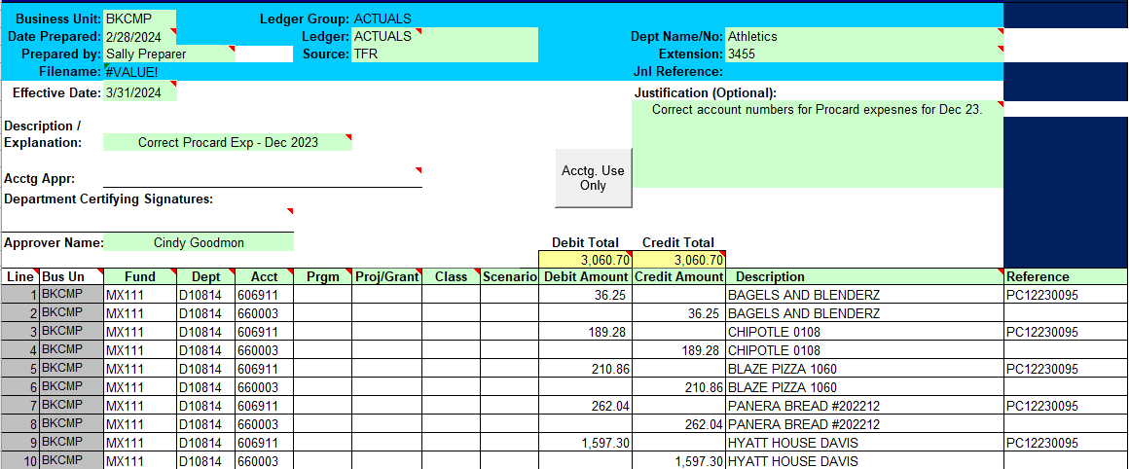
Campus Accounting & Reporting Services
Expenditure Transfer Example
Contact:
Liz Gamez - accounting@csub.edu

Slide 6
Campus Accounting & Reporting Services
Miscellaneous Department Revenues
Please contact our office if any of the following applies to revenues received and deposited into campus funds or miscellaneous trust funds (MX--- funds):
Revenues received for services provided to general public or external parties (for-profit organizations or non-educational institutions).
Revenues received for services that are not related to a CSUB course and do not involve volunteer work from students.
Revenues received for the rental of facilities or equipment to general public or external parties (for-profit organizations or non-educational institutions).
Revenues or commissions from sales of items to general public, alumni, (non-students).
Revenues are received on a regular basis (i.e weekly, monthly or quarterly).
If these apply, please do the following;
Contact Adam Bye, Accountant III, ext. 2205, abye@csub.edu.
We will provide you with the proper account codes to use for revenues.
We will notify you if there are any tax implications related to this revenue.
Review Trust Agreement form and make any necessary updates to include new sources of funds.
Contact:
Liz Gamez - accounting@csub.edu

Slide 7
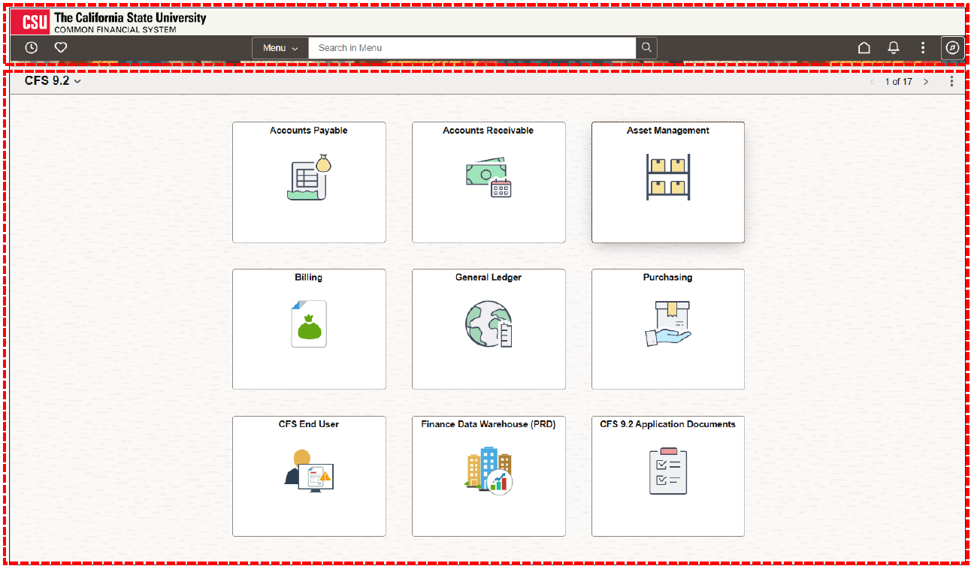
Campus Accounting & Reporting Services
CFS Maintenance Pack 6.0 Update
Go Live:
April 28th
CFS updates includes:
Layout changes and new color scheme
New location for Menu and Favorites
Expanded search features.
Contact:
Liz Gamez - accounting@csub.edu

Slide 8
Budget Office
FY 2024-25 Budget Transfers
Final day to submit Friday, June 20, 2025
Questions??
ORG-Budget@csub.edu
Contact:
Natasha Hayes - ORG-Budget@csub.edu

Slide 9
Sponsored Programs Post Award
SPA Grants
Deadline to turn in all SPA FY 2024-25 invoices to SPA
Accounting.
SPA Accounting will manually accrue all FY 2024-25
invoices submitted to Post Award by noon July 8th.
(All grant-related paperwork is due in Post Award by
July 03, 2025)
Manual accrual list must be submitted to the Grants
Accountant for all individual FY 2024-25 invoices greater
than $100 that were not submitted to Post Award by
July 3rd deadline.
Tuesday
07/08/2025
Gipsy Mejia
Noon
X2875
Friday
07/11/2025
Note: To avoid a duplication, invoices submitted to Post Award for payment should not be on the June accrual list.
Contact:
Rosalba Flores– spaaccounting@csub.edu

Slide 10
Foundation
Deposits to BKFDN
All deposits (checks, cash, credit cards) for BKFDN are handled by the University Advancement gift processor for proper recording, document retention, and tax receipting
Drop off to UA or contact for pick up
Include note or documentation on the nature of the payment and the fund(s) to be credited
One-time administrative fee of 5% is required on all fundraising activities (i.e., donations, sponsorships, ticket sales, and auction purchases)
Org Inbox Contact: foundationaccounting@csub.edu
Contact:
Jassica Gauna- jgauna@csub.edu

Slide 11
Foundation
Gift-in-Kind Acceptance
Non-cash donations (i.e. goods, equipment, property, services)
GIK form must be submitted and approved by Foundation Executive Director before accepting and receiving the gift
Memo to campus with additional information
Fundraising Events Sponsorships
Fundraising event approval form required per CSU policy
Sponsorship packets must be reviewed by UA Accounting to evaluate benefits provided to sponsors for tax deductibility
Contact:
Jassica Gauna- jgauna@csub.edu

Slide 12
Payment Services
All communication should be submitted to accounts_payable@csub.edu
May 2: Direct Pays and invoices through April 30th are due
May 9: Travel claims for travel ending through April 25th are due
June 3: May AP paperwork due
June 5: All FY24/25 AP paperwork due
June 5: May & Early June travel claims due
June 5: *Accruals for travel due. A FY24-25 Travel Accrual PowerForm must be submitted.
*No travel ending before April 8, 2025 will be accrued because CSU policy requires travel claims to be submitted no later than 60 days after the end of travel. No exceptions.
Contact:
Hillary Castellano
hcastellano@csub.edu

Slide 13
Payment Services
Paperwork:
Paperwork received after the deadlines may not be accrued or paid before year-end.
If you submit a travel claim before June 30th that was submitted on a Travel Accrual Form, please note that prominently on the claim & attach a copy of the accrual form as the first page of the travel claim.
Contact:
Hillary Castellano
hcastellano@csub.edu

Slide 14
Payment Services
Procurement Card (ProCard)
The ProCard billing cycle for June is May 13 through June 10, 2025.
The reconciliation period in PeopleSoft for the June statement is June 11 through June 24, 2025 (7 business days).
Please Note:
When the reconciliation period ends, the charges for June will be final. They cannot be transferred before year-end and cannot be transferred in the following year.
Use tax chargebacks for purchases made in the June 2025 billing cycle will be posted to the FY 2025-26 budget.
Contact:
Hillary Castellano
hcastellano@csub.edu

Slide 15
Payment Services
Open Lab Topic | Day | Time
ProCard | Monday | 10:00 am
Procurement | Tuesday (Bi-Weekly) | 09:00 am
Travel | Wednesday | 10:00 am
AP/Invoice | Thursday | 10:00 am
Hospitality | Thursday | 11:00 am
Contact:
Hillary Castellano
hcastellano@csub.edu

Slide 16
Labor Cost Distribution (LCD)
Please refer to the year-end memo for specific deadlines.
All Payroll Move Request and PCAR forms with grant related funding must be submitted to Post Award (previously known as GRASP) for review and approval prior to sending to HR.
REMINDER: Any payroll moves into BK001 must be submitted by May 2, 2025.
Additional Assistance / Q&A Opportunities
Labor Cost Distribution (LCD) User Support Group
Contact Lucero San to be added to the group
LCD/PC Open Lab session (via Zoom)
Invitation will be sent out in May for June 10th
Contacts:
Human Resources – hr@csub.edu | Tina Williams – twilliams@csub.edu | Lucero San – lsan1@csub.edu

Slide 17
Payroll
All monthly June Payroll dated on or before July 1, 2025
will be charged to FY 2024-25 budget.
Employees that are paid for month of June on July 14, 2025
will be charged to the FY 2025-26 budget
(this includes prior pay period late time).
Hourly and Special Consultant Payroll for Grant programs ending June 30, 2025
must be submitted to HR/Payroll by June 13, 2025 for these transactions to be charged to FY 2024-25.
Contacts:
Human Resources – hr@csub.edu | Tina Williams – twilliams@csub.edu Patrice Baker – pbaker@csub.edu

Slide 18
Procurement and Contract Services
CRITICAL DEADLINES
May 8, 2025
BK001 Requisitions $5,000 and greater must be submitted in CSUBUY Procure-to-Pay (P2P) with required approvals.
Non-BK001 Requisitions $25,000 and greater, including Public Works projects, must be submitted in CSUBUY Procure-to-Pay (P2P) with required approvals.
May 29, 2025​
BK001 Requisitions less than $5,000 must be submitted in CSUBUY Procure-to-Pay (P2P) with required approvals. ​
Non-BK001 Requisitions less than $25,000 must be submitted in CSUBUY Procure-to-Pay (P2P) with required approvals.
Note: Any requisitions not meeting the above due dates will be held for processing in FY 2025-26.
Procurement cannot guarantee any requisitions submitted by the due date will be processed in current FY if additional approvals are needed or processes required, such as contract creation or bid process.

Slide 19
Procurement and Contract Services
FY 2025-2026 Requisitions
Requisitions for the new FY may be submitted in CSUBUY P2P as of June 2 (do not submit before this date). Please be sure to input an Accounting Date of 7/1/2025 and add a comment that PO is for “FY 2025-26.”
Any POs processed after 6/2 will be held for release until 7/3 unless there is a critical need to release early, contact Procurement to discuss.
All requisitions submitted on or after June 2 will go to Procurement for processing, including punchout catalog items (i.e. Staples, Amazon) that are low risk and low dollar that normally would not go through Procurement.
Contact: Procurement@csub.edu

Slide 20
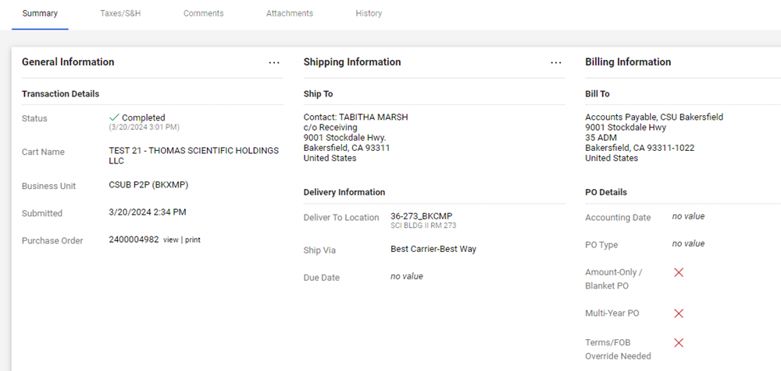

Slide 21
Procurement and Contract Services
Annual Renewals and Blanket Purchase Orders
Annual renewals and blanket PO requisitions can be submitted on or after Monday, June 2, 2025 with an Accounting Date of 7/1/25 or later and a comment that PO is a blanket or annual renewal for FY 2024-25.
On or after July 1, the accounting date and comment is no longer necessary.
CSUBUY P2P provides visibility to requestors for all requisitions submitted and the search functionality is simple and easy to use, therefore, Procurement will no longer provide a listing of all campus blankets and annual renewals.
For blanket POs that are a combination of goods and services, please be sure to create at least two lines, one for taxable goods and one for non-taxable services.
Contact: Procurement@csub.edu

Slide 22
Student Financial Services
Preferred Contact:
University Accounts Receivable: accounts_receivable@csub.edu
A staff member will respond within 2 business days.
University Centralized Billing
The CO has mandated that University billing be centralized (non-student).
All third party billing, including billing to any Auxiliary, has to be processed by the University Accounts Receivable (AR) Accountant.
Contact:
SFS AR Email- accounts_receivable@csub.edu

Slide 23
Student Financial Services
AR CRITICAL DATES TO REMEMBER
May 5th - All Billing Request Forms through 4/30/2025 are due from departments.
June 5th - All Billing Request Forms through 5/31/2025 are due from departments.
June 5th - All Billing Request Forms for the month of June 2025 are due from departments.
June 5th - Petty Cash activity through 6/5/2025 are due to the Cashier’s Office.
Deposits & Petty Cash Amy Polston...............6204
Accounts Receivable (Off Campus) Valeria Rodriguez.......3975
Accounts Receivable (Student & On Campus) Christina Orozco.........3225
Contact:
SFS AR Email- accounts_receivable@csub.edu Cashiering Office- cashiersoffice@csub.edu

Slide 24
Journal Entries and Expense Transfers,
Journal entries including expense transfers should be sent to the following departments whose business unit is initiating the journal entry and/or expense transfer:
BKCMP – Liz Gamez or accounting@csub.edu
BKASI - Elizabeth Walker or studentaffairsaccounting@csub.edu
BKFDN - Jassica Gauna or foundationaccounting@csub.edu
BKSTU - Elizabeth Walker or studentaffairsaccounting@csub.edu
BKSPA - Rosalba Flores or spaaccounting@csub.edu
Reminder - New BK001 Deadline for expense transfers to BK001 is May 2, 2025.

Slide 25
April 2025
Deadlines for Transactions Relating to months through Fiscal Year 2024-2025
(All state-side grant-related paperwork listed below is due in Post Award by April 18, 2024).
April 18, 2025 – Labor Cost Distribution (LCD) payroll moves related to the month of March 2025.
April 26, 2024 – Procurement: Requisitions $25,000 or greater submitted in CSUBUY Procure-to-Pay (P2P) with all appropriate approvals.
May 2, 2025 – Direct Pays and invoices through April 30, 2025.
May 2, 2025 – Chargebacks through April 30, 2025.
May 2, 2025 – Journal entries for transactions up through April 30, 2024.
May 2,2025 –BK001 Journal entries for transfer to BK001 for fiscal year June 30, 2025. No journal entries including payroll moves with transfers-in will be allowed following May 2nd.
May 5, 2025 – Billing request forms for activity related to the month of April 2025.
May 9, 2025 – Travel claims for travel ending through April 25, 2025
NOTE: No travel ending before April 8, 2025, will be accrued, so departments need to submit the claims by the deadlines to be charged against the FY24-25 budget.
May 2025
Deadlines for Transactions Relating to Fiscal Year 2024-2025
(All state-side grant related paperwork listed below is due in Post Award by May 17, 2024).
May 10, 2024 -Procurement: Requisitions less than $25,000 submitted in CSUBUY P2P with all appropriate approvals.
May 20, 2025 - Labor Cost Distribution (LCD) payroll moves related to the month of April 2025. See May 2nd for BK001 deadline.
May 23, 2024 -Procurement: Public Works Project Requisitions submitted in CSUBUY P2P
with all appropriate approvals.
June 2, 2025 - Direct Pays and invoices through the month of May 2025.
June 2, 2025 - Journal entries for the month of May 2025.
June 2, 2025 - Chargebacks for the month of May 2025.
June 5, 2025 - Travel claims through May 2025.
June 5, 2025 - Billing request forms for activity related to the month of May 2025.
June 2025
Deadlines for Transactions Relating to Fiscal Year 2024-2025
(All state-side grant-related paperwork listed below is due in Post Award by May 23, 2024).
June 5, 2025 - Billing request forms for activity related to the month of June 2025.
June 5, 2025 - Direct Pays and invoices for the month of June 2025.
June 5, 2025 - Travel claims through June 4, 2025.
June 5, 2025 - Travel claims estimate for June (through June 30, 2025)
June 20, 2025 - Labor Cost Distribution (LCD) payroll moves related to the month of May 2025. See May 2nd for BK001 deadline.
Key Deadline Summary

Slide 26
Departmental Email Addresses
Financial Services:
Accounts Receivable: accounts_receivable@csub.edu
Campus Accounting : accounting@csub.edu
Cashiering: cashiersoffice@csub.edu
Foundation accounting: foundationaccounting@csub.edu
Student Affairs Accounting: studentaffairsaccounting@csub.edu
Student Financial Services: sfs@csub.edu
Sponsored Programs Post Award spaaccounting@csub.edu
Budget and Payroll:
Budget: ORG-Budget@csub.edu
Payroll: payroll@csub.edu
Businesses Services:
Payment Services (A/P & Travel): accounts_payable@csub.edu
Procurement & Contracts: procurement@csub.edu
ProCard: procard@csub.edu

Slide 27
Questions and Answer Session from Campus

