Slide 1
Role of tad-like loci in the attachment of the plant pathogenic bacterium Rhodococcus fascians to its host
Fiya Grace Manoj

Slide 2
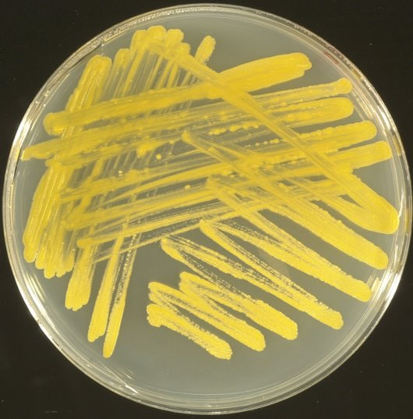
Rhodococcus fascians
Plant pathogenic
bacterium
Broad host range
Photo credit: Dr. Vereecke

Slide 3
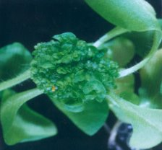
Leafy galls
Deformation on upper part of the plant
Small shoots and leaves at the site of infection
Provides protection for bacteria and changes metabolism of the plant to produce sugars that will only benefit the bacteria
Bacteria produces similar growth hormones as plant that allows it to grow on the plant.
Photo credit: Dr. Vereecke

Slide 4
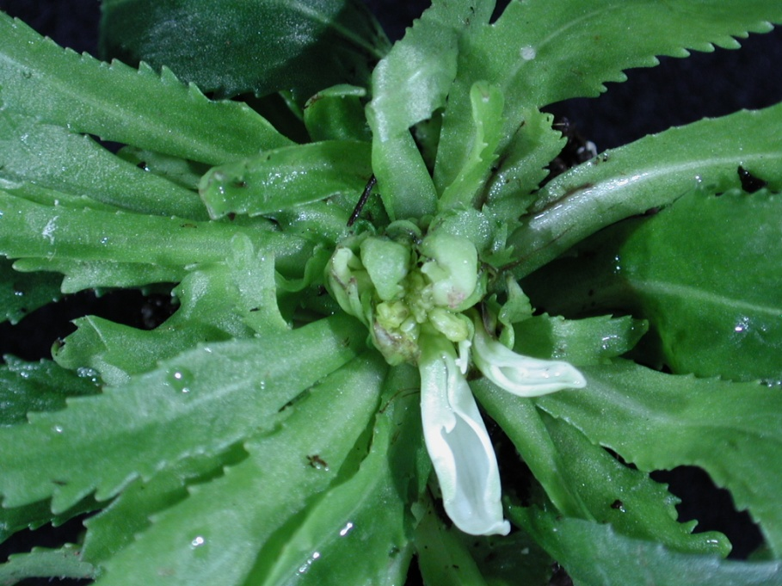
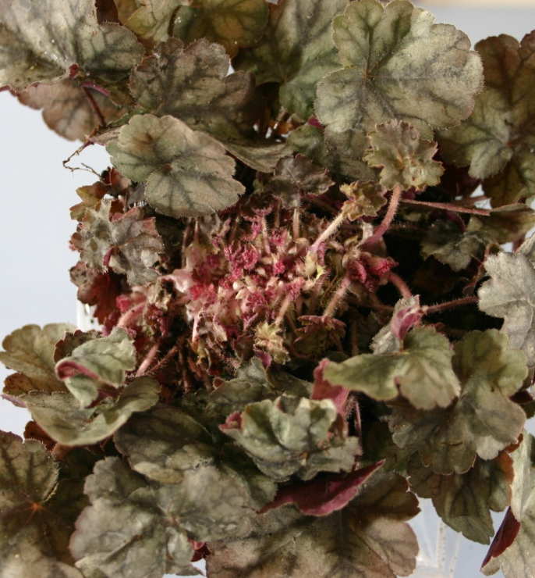
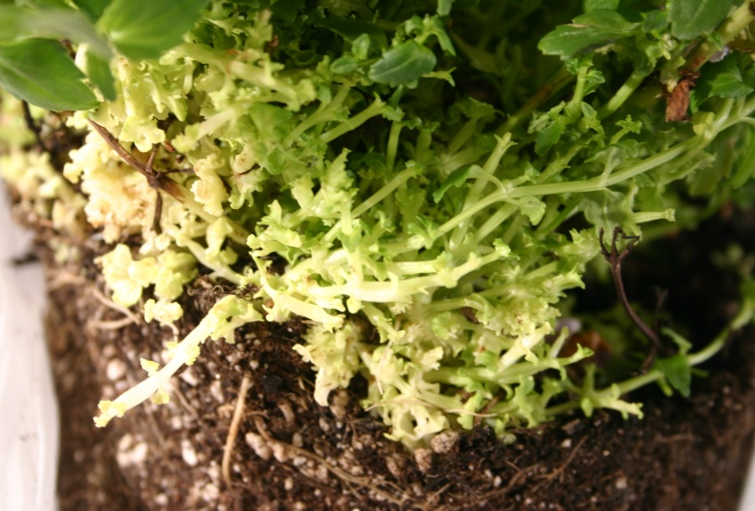
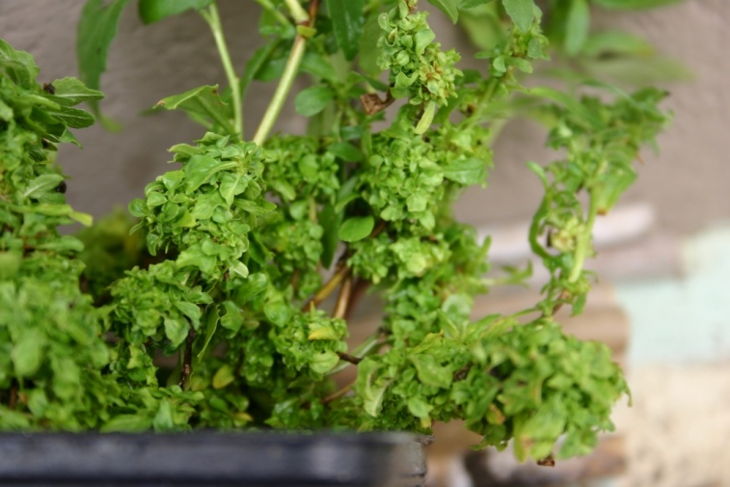
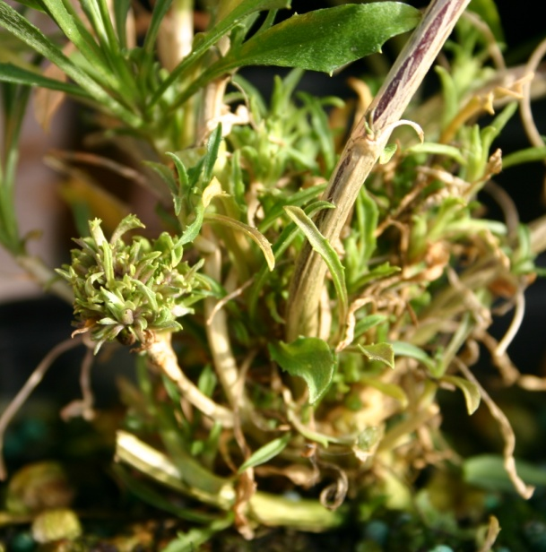
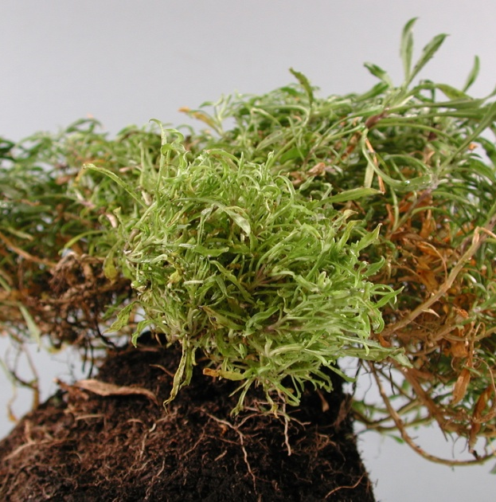
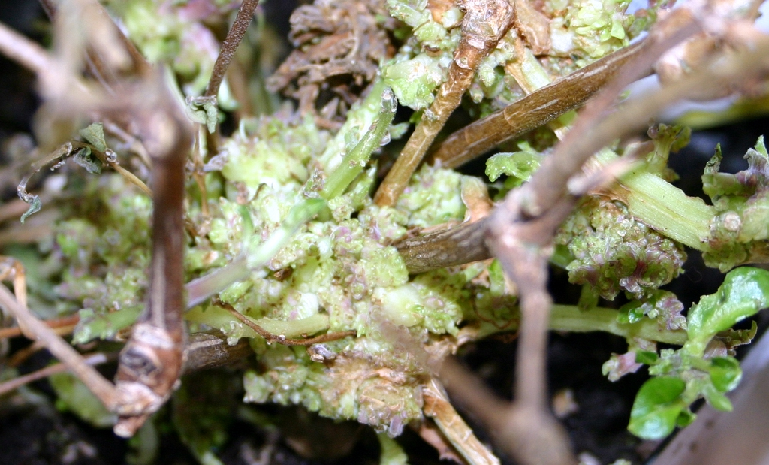
Photo credit:
Dr. Vereecke

Slide 5
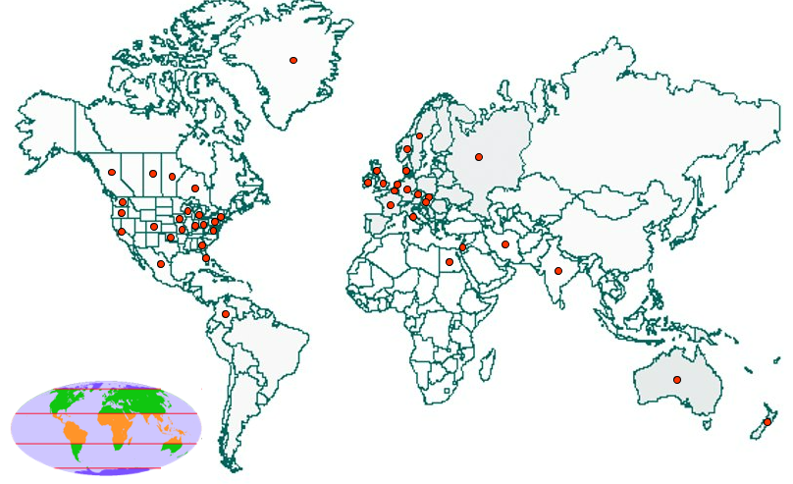
Significant economic loss in the ornamental industry
There's no method for disease management so to find a control mechanism we need more information on the pathogen.
Understanding how the bacteria behaves and virulence strategies could be the key to prevention and control.
Photo credit: Dr. Vereecke

Slide 6
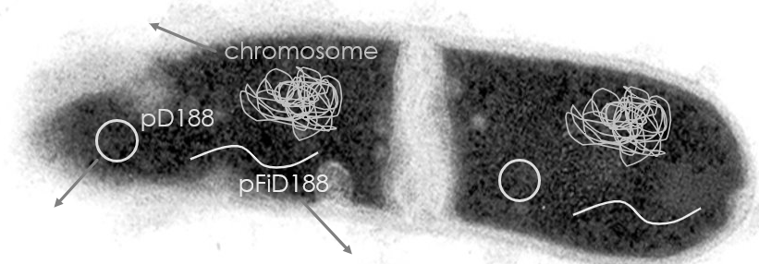
How does the bacterium make the plant sick?
Most functions unknown
Role in phytopathogenicity
Metabolic adaptation to life inside the leafy gall
Production of auxin
The genome of Rhodococcus fascians strain D188
Heavy metal resistance
No role in phytopathogenicity
Fasciation inducing plasmid
Essential for phytopathogenicity
Virulence genes
Production of cytokinins
Photo credit:
Dr. Vereecke
Two loci have high homology

Slide 7
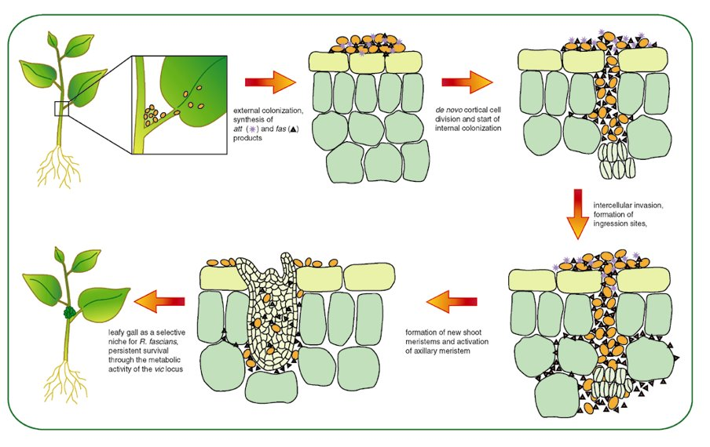
Mechanism of how the plant gets sick
Leafy gall formation is a multistep process
Photo credit:
Dr. Vereecke

Slide 8
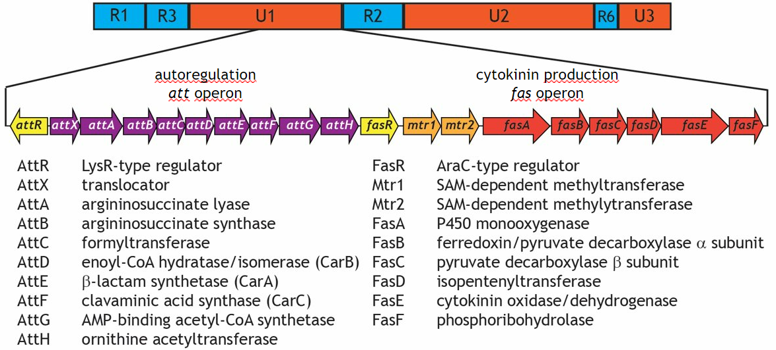
pFiD188, linear virulence plasmid
Photo credit: Dr. Vereecke
The most important virulence loci are the att and fas operons
Previous researchers have manipulated these genes and found no formation of leafy galls.

Slide 9
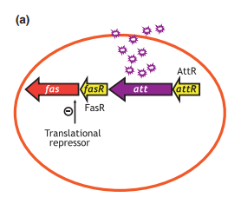
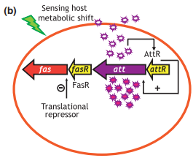
Att operon on linear plasmid
The first genes to be activated are the att genes.
Once the bacteria colony reaches a certain density more att genes are activated and there is hyperactivation of the att genes
Photo credit: Dr. Stes

Slide 10
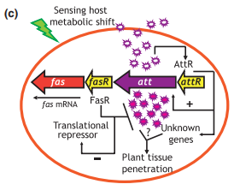
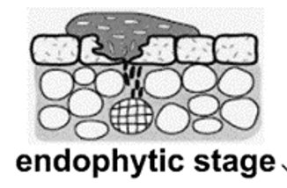
Fas operon on linear plasmid
The high levels of att triggers the penetration of the plant tissue making the bacteria become an endophyte and triggers the expression of the fas genes.
The fas genes code for cytokinin and activate existing meristems leading to the formation of leafy galls.
Photo credit: Dr. Stes

Slide 11
Leafy gall formation
We know the att and fas genes are located on the linear plasmid and are used in virulence of the bacteria but we do not know how the bacteria initially attacks to the host plant.
Photo credit:
Dr. Vereecke

Slide 12
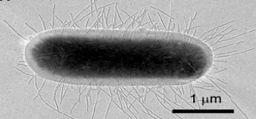
Attachment
Pathogens need to attach to the host to survive.
Pili are tools for attachment.
Photo credit: Guido Capitani

Slide 13
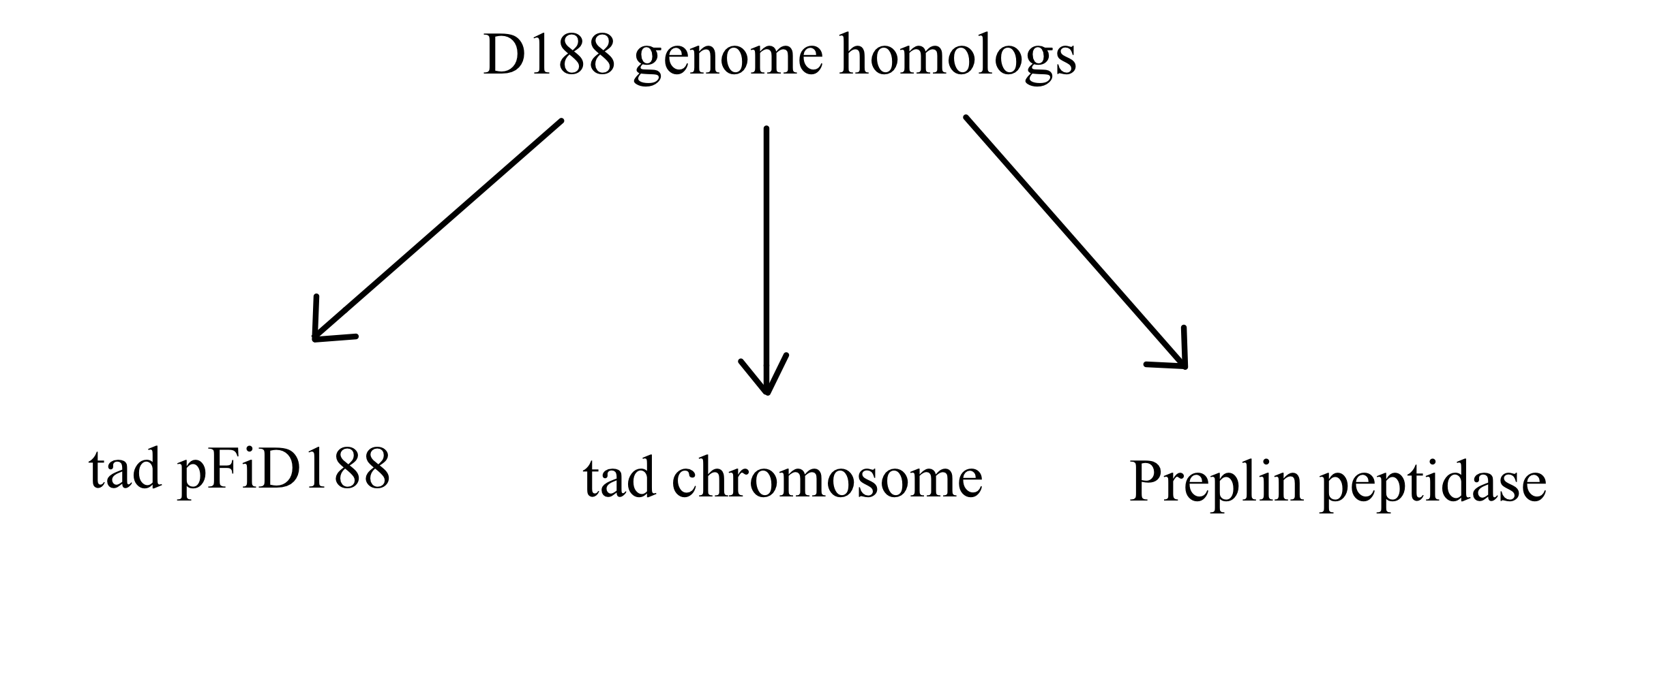
Identifying one of the three gene clusters if any are responsible for the attachment of the bacteria to the plant host.
Identify by making mutants of all three

Slide 14
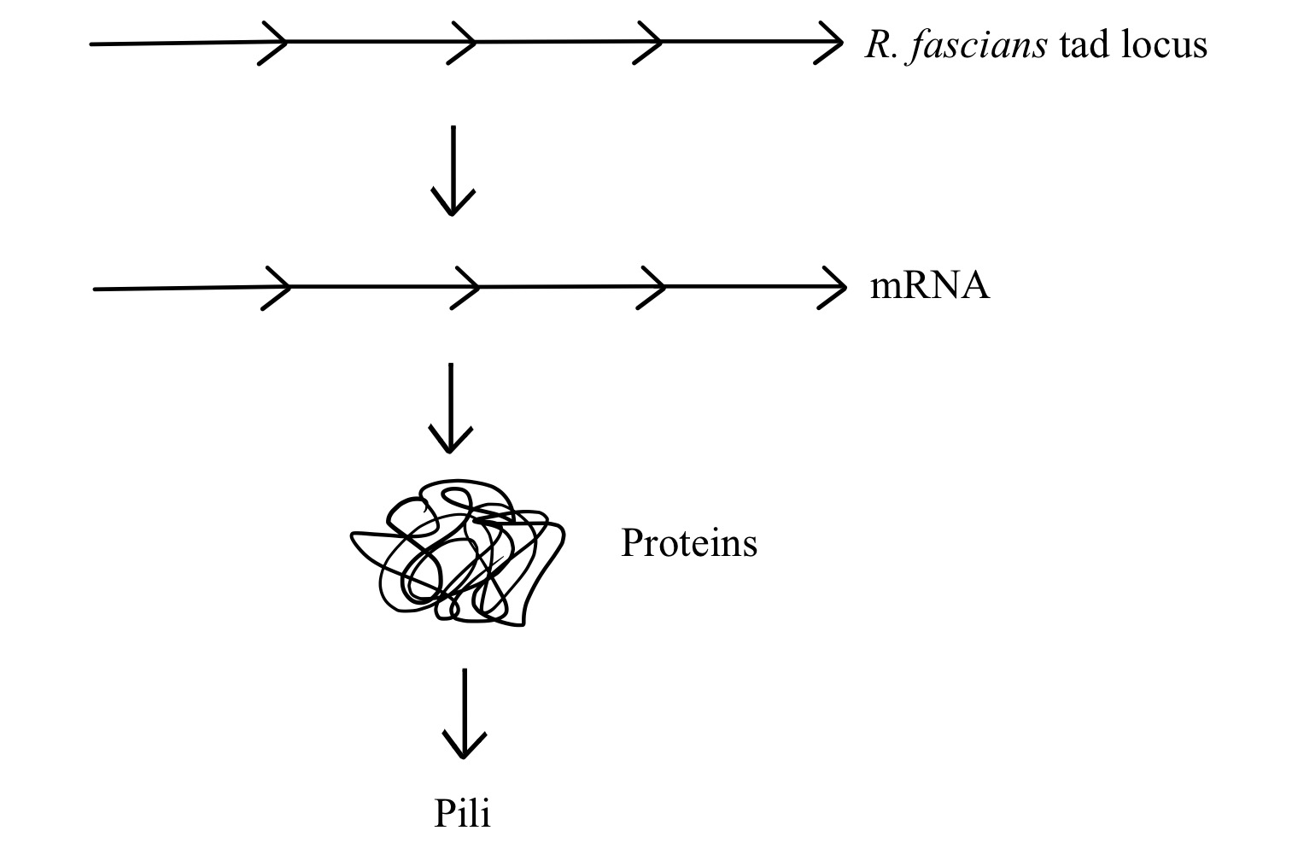
How do you make a mutant?

Slide 15
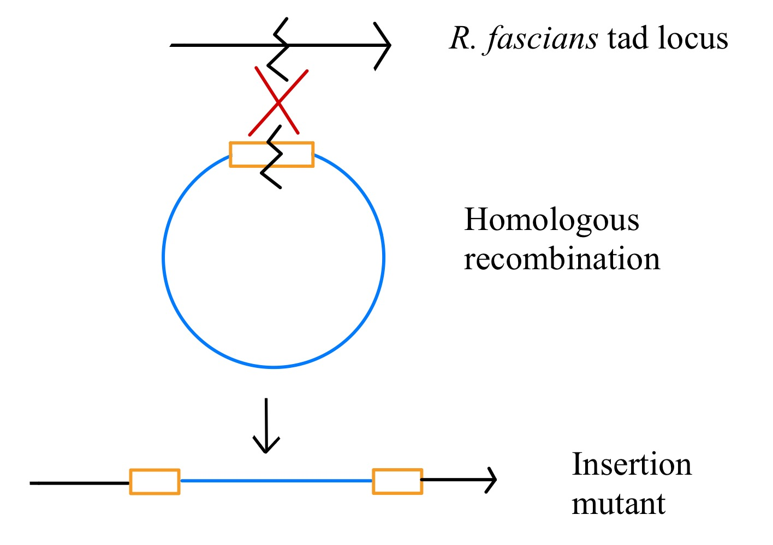
How do you make an insertion mutant?

Slide 16
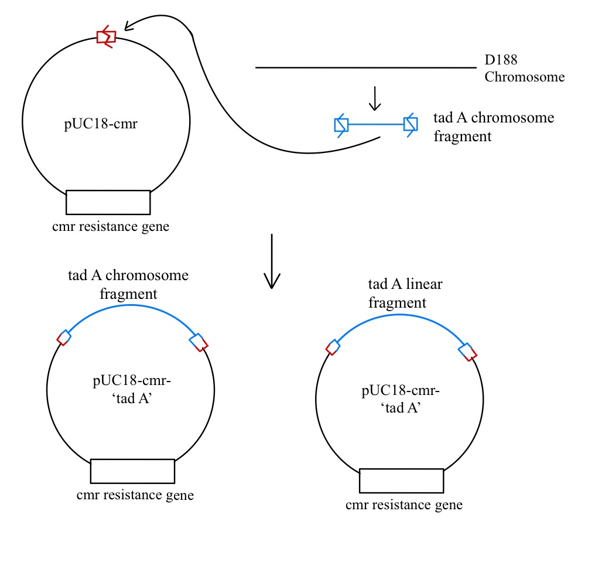
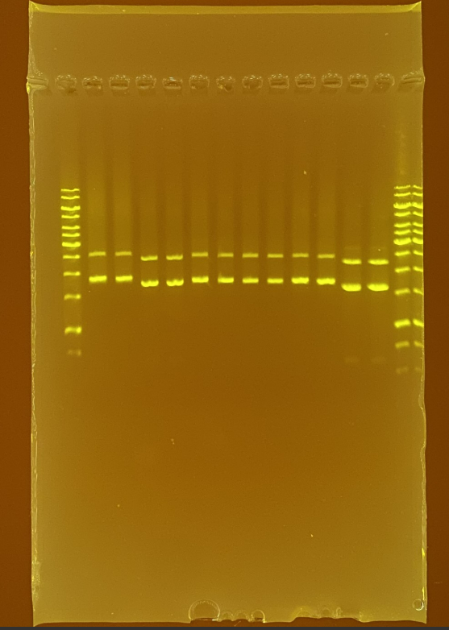
How do you make the plasmid insert?

Slide 17
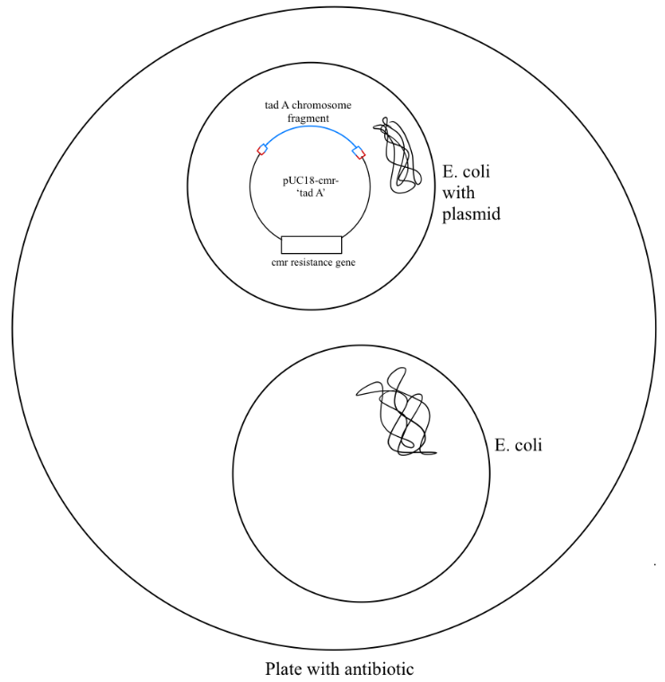

Slide 18
Assays will test if interfering with the tad locus has any affect on virulence or attachment

Slide 19
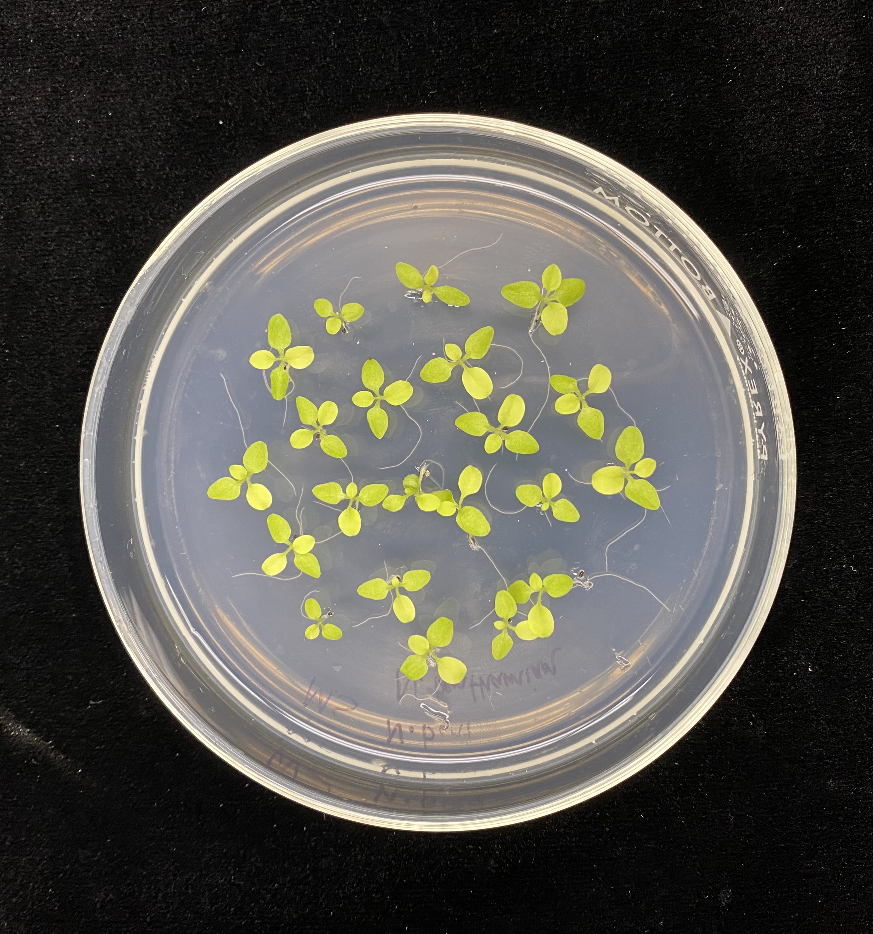
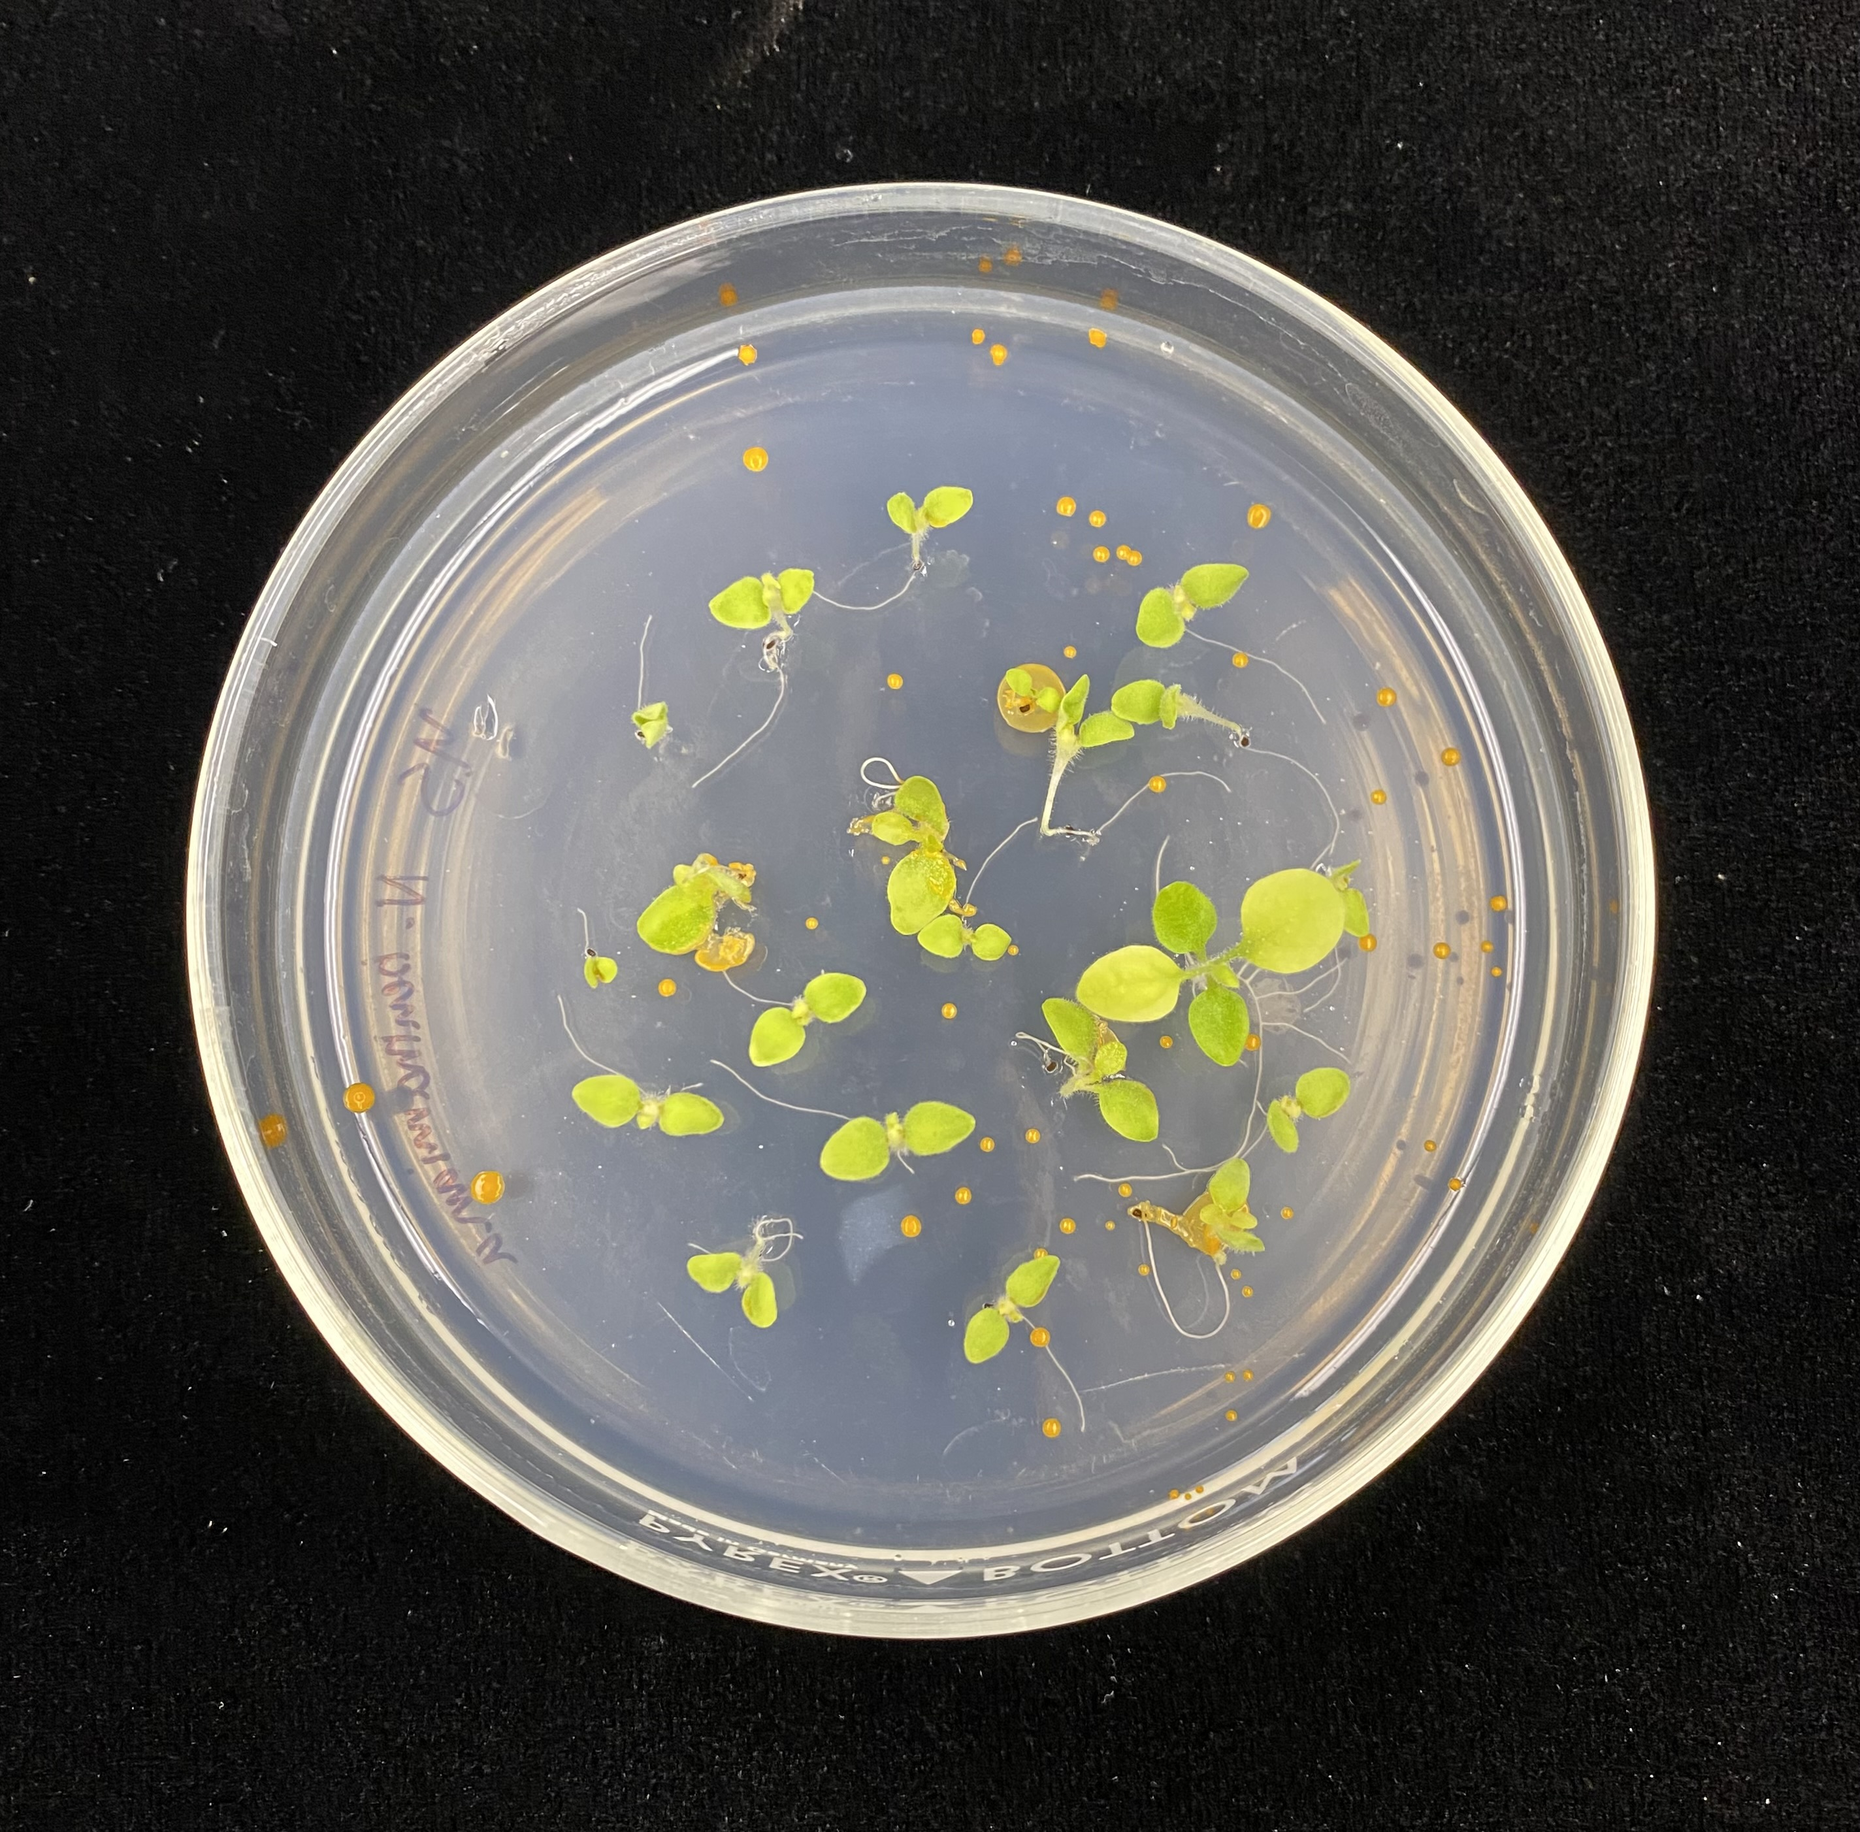
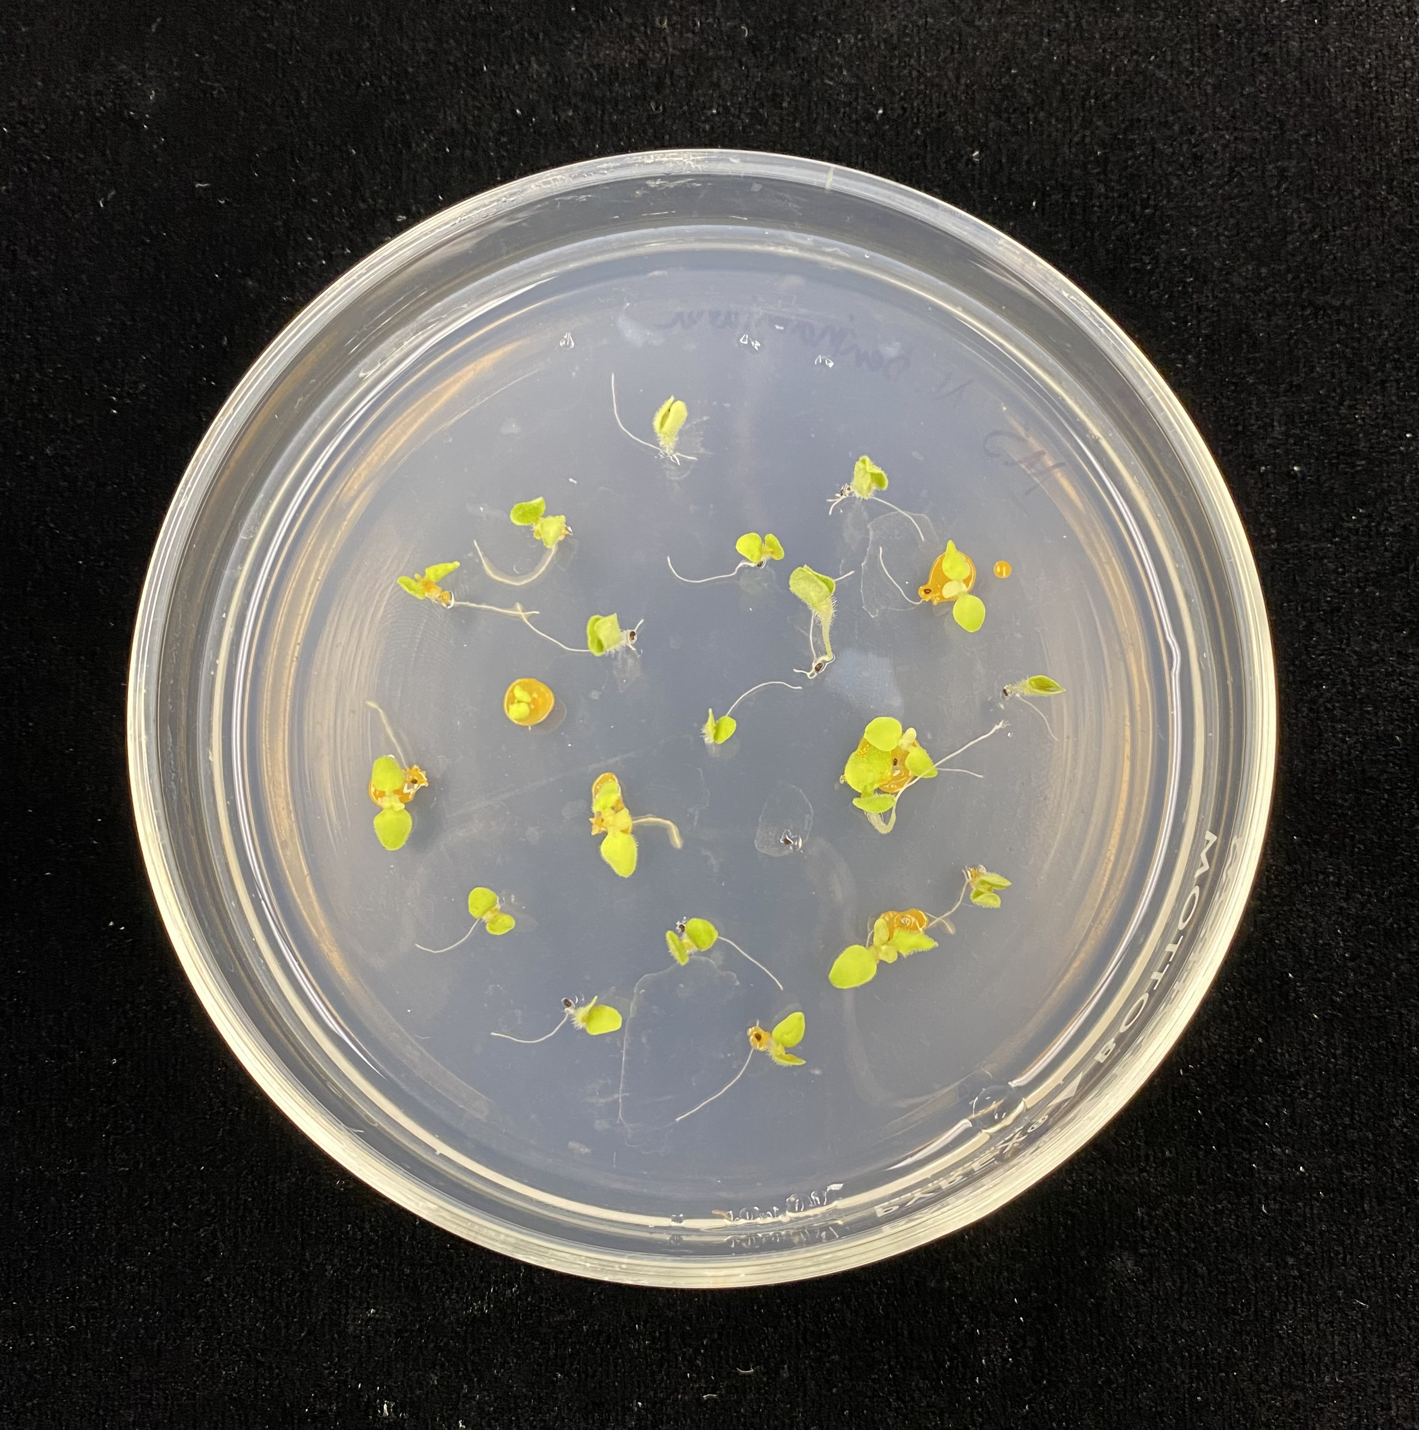
Virulence assays
Virulence assay
Seedling
Water
D188
Prep mutant

Slide 20
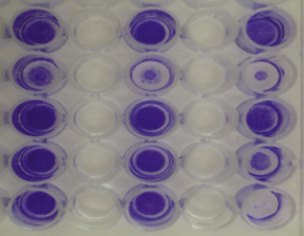
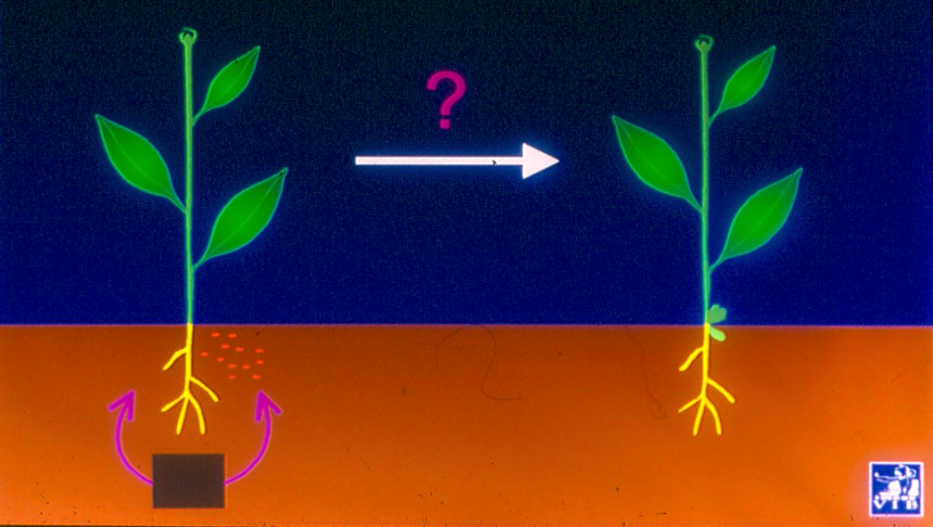
Plant assays
Virulence assay
Seedling
Attachment
Crystal violet
Motility assay
Water next to the plant
Photo credit: Dr. Stes

Slide 21
Acknowledgement
Dr. Isolde Francis
Dr. Danny Vereecke

