Slide 1
Biocontrol of Southern blight by Streptomyces species isolated from Kern County
TJ Moreno
November 2023

Slide 2
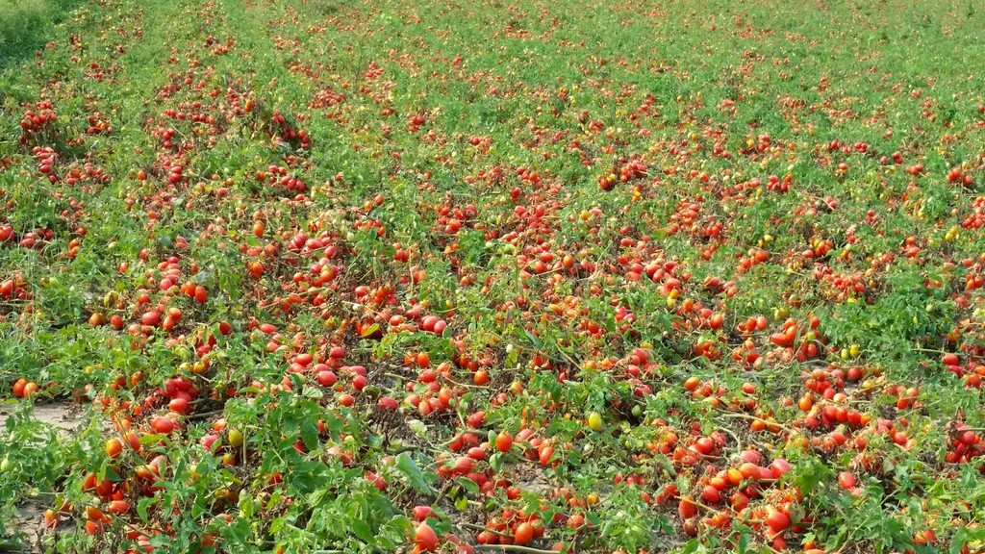
Tomato Yield
$126,596,000

Slide 3
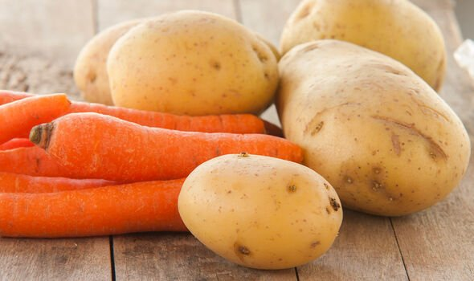
Other Crop Yield
Carrots: $583,314,000
Potatoes: $192,577,000

Slide 4
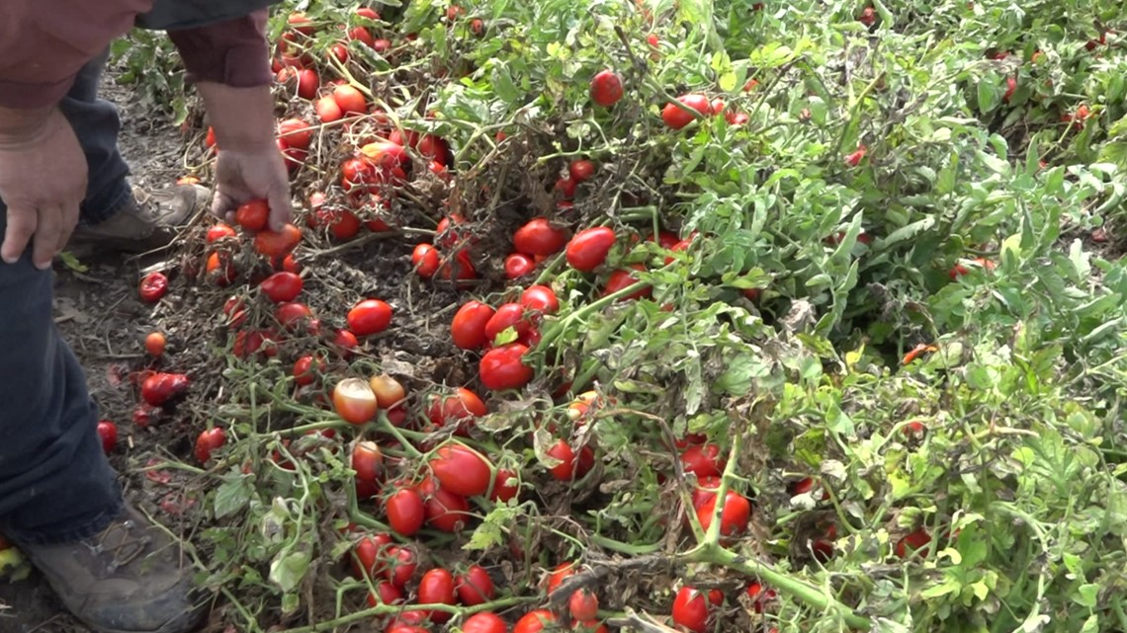
Tomato Plant (Solanum lycopersicum)
Grown on ground for easier mechanical harvest
Summer plant

Slide 5
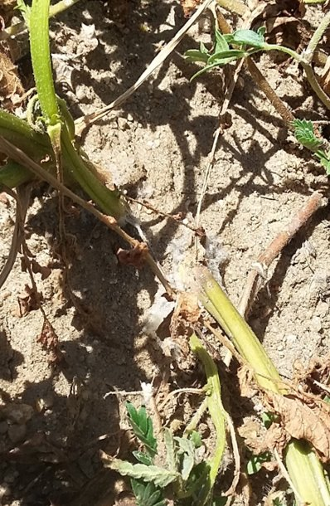
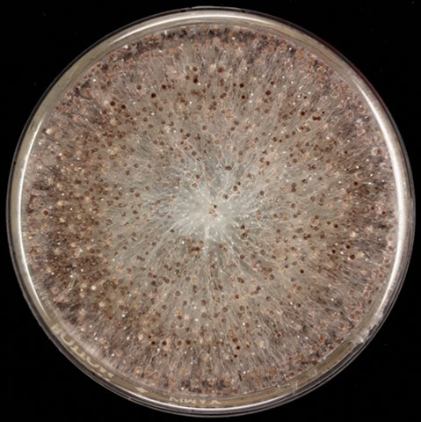
Southern Blight (Sclerotium rolfsii)
Wide host variety
Heat loving
Attacks the crown
Weak mycelium
Strong sclerotia

Slide 6
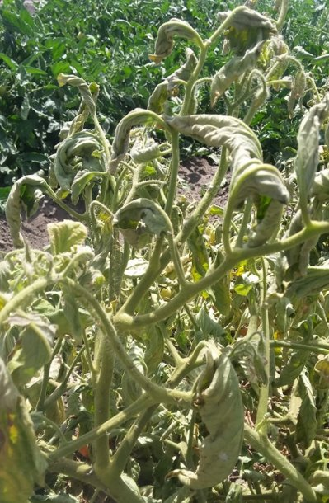
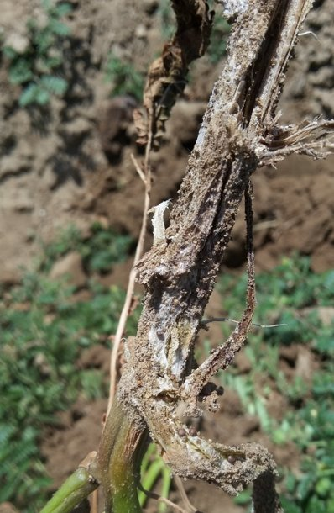
Problems
Heat loving fungus
Strong sclerotia form and can survive for multiple years in the soil
Broad host range
Heat loving plant
Leaf canopy covering soil
Irrigation causes water log

Slide 7
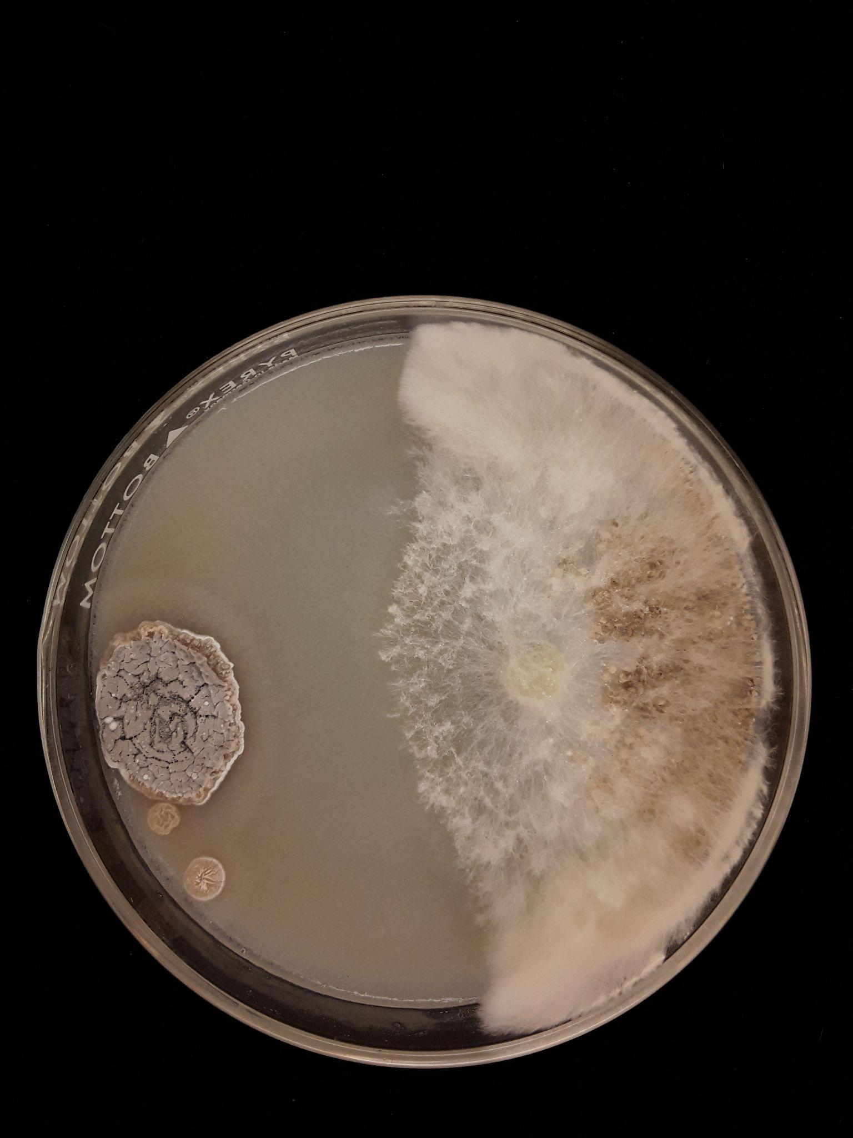
Streptomyces GM18-153
Heat loving
Strong inhibition

Slide 8
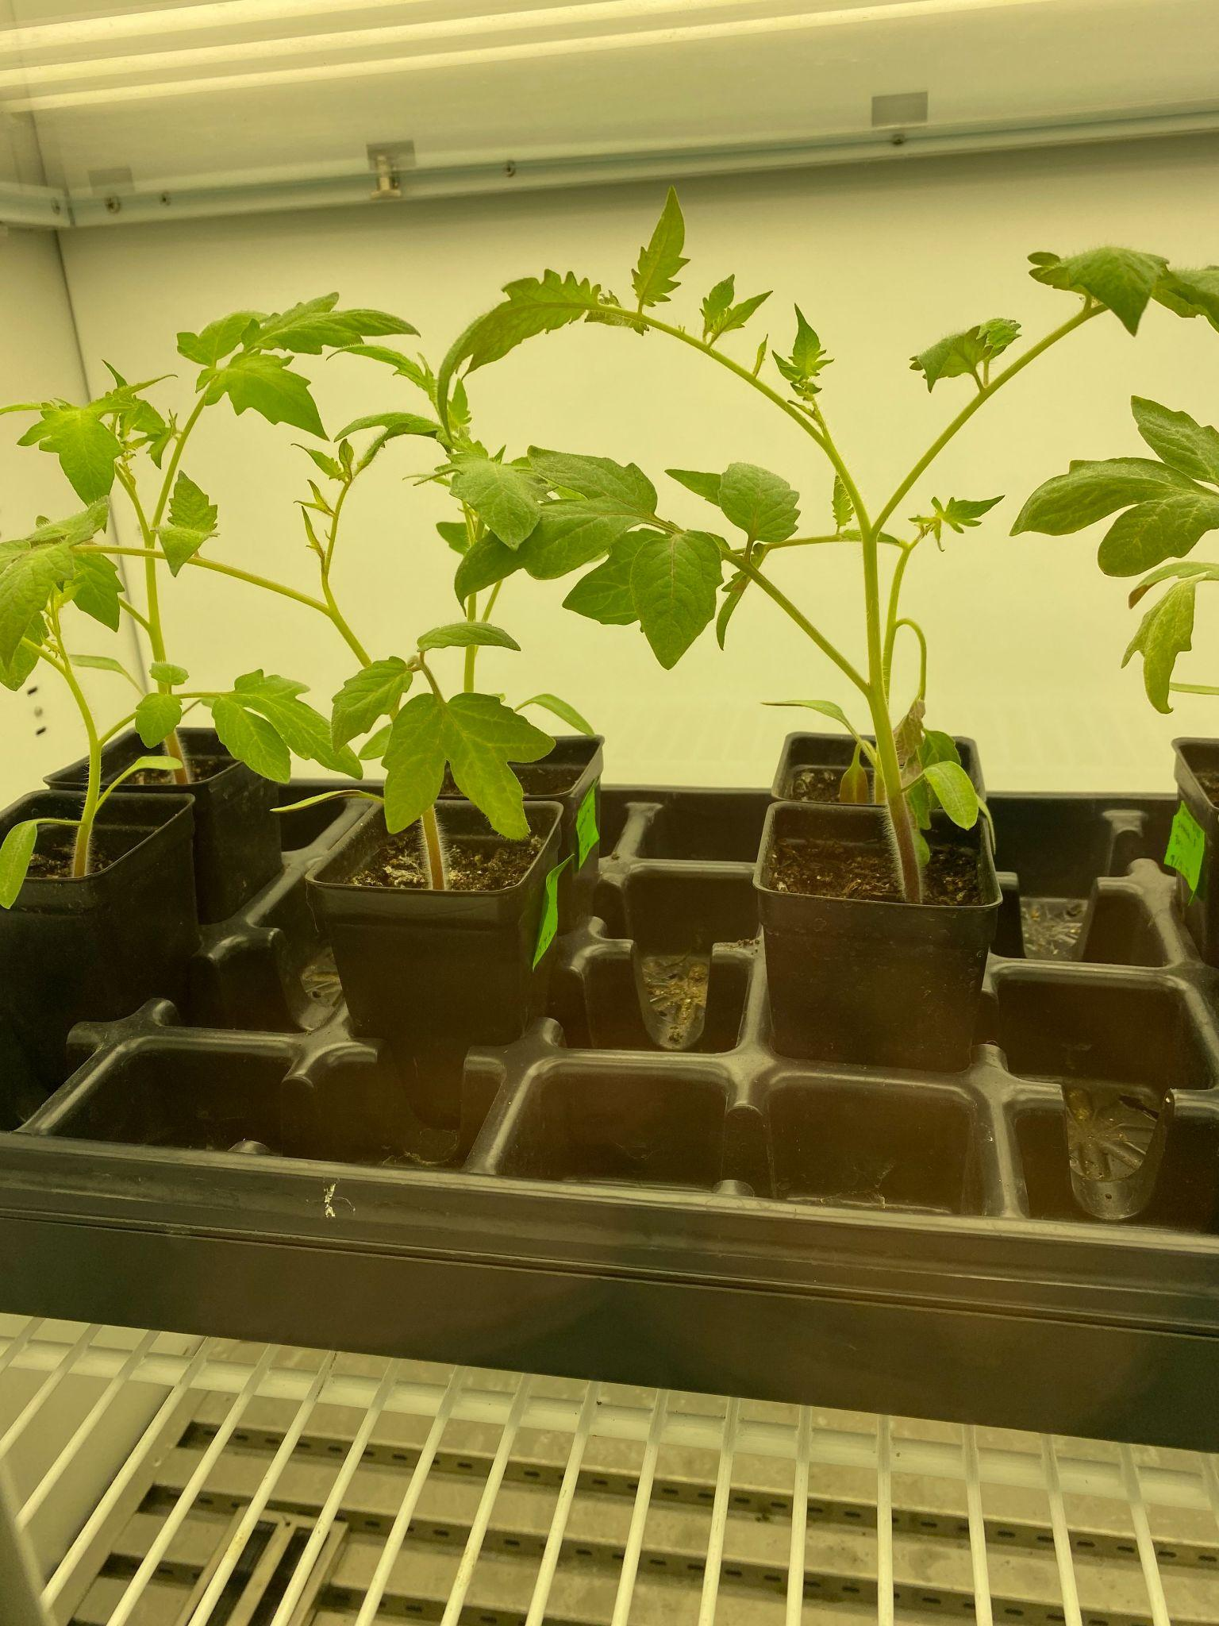
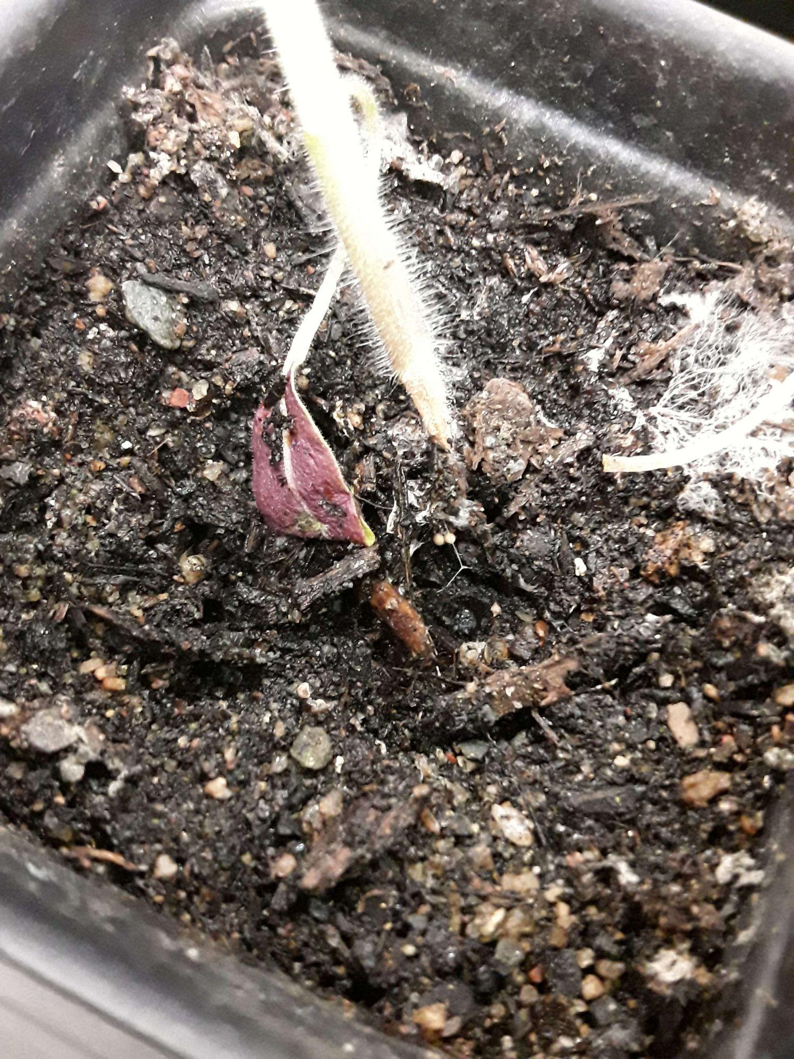
Bioassays

Slide 9
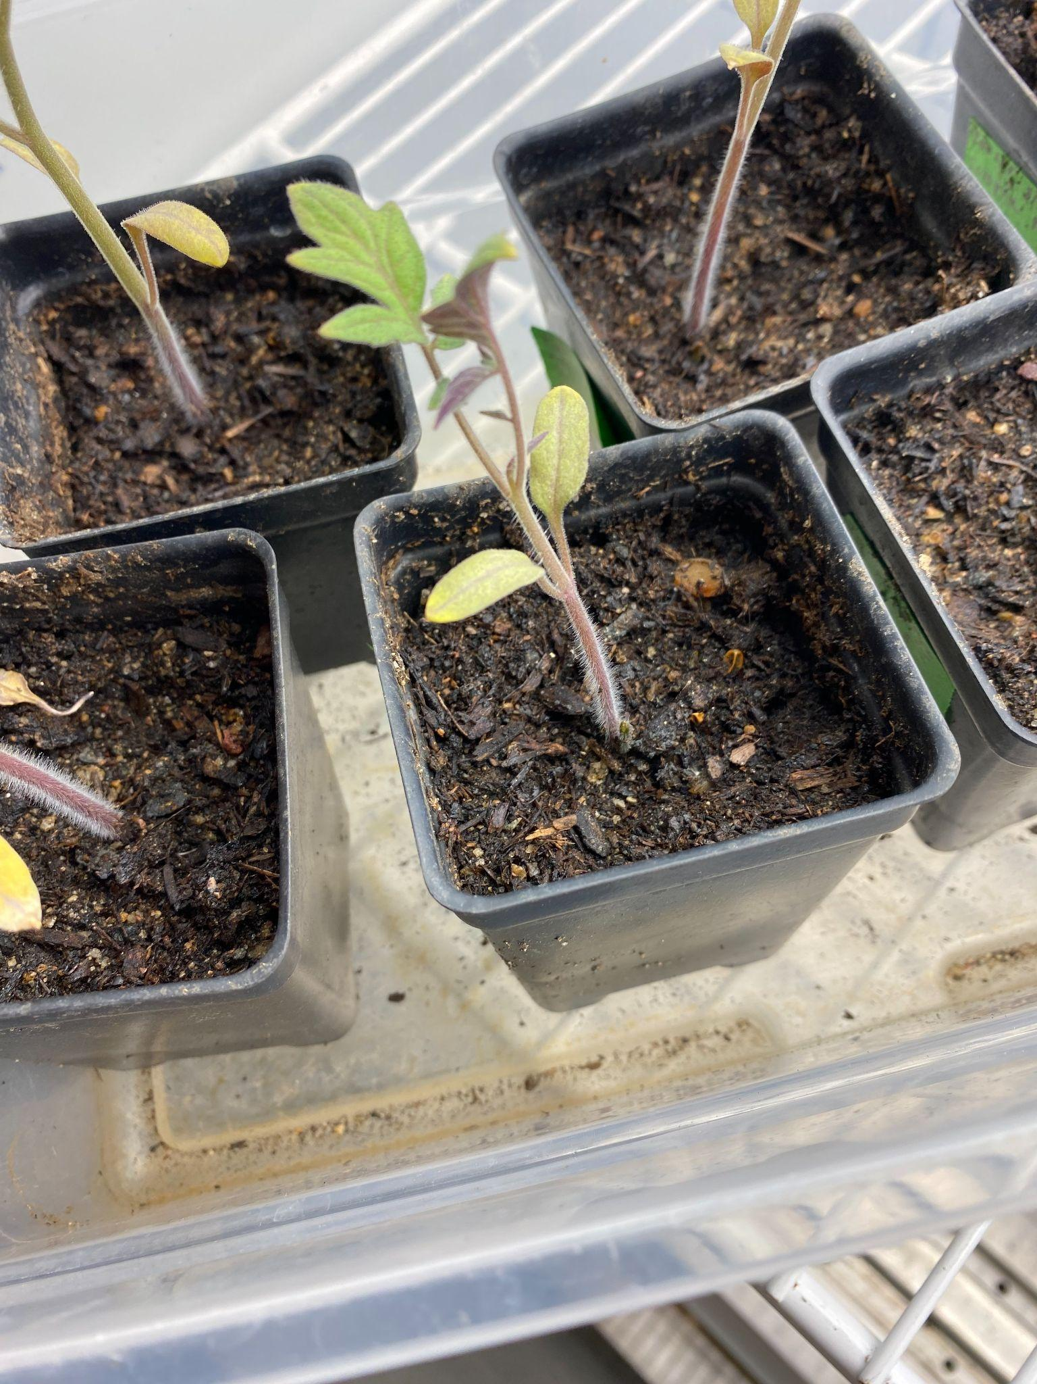
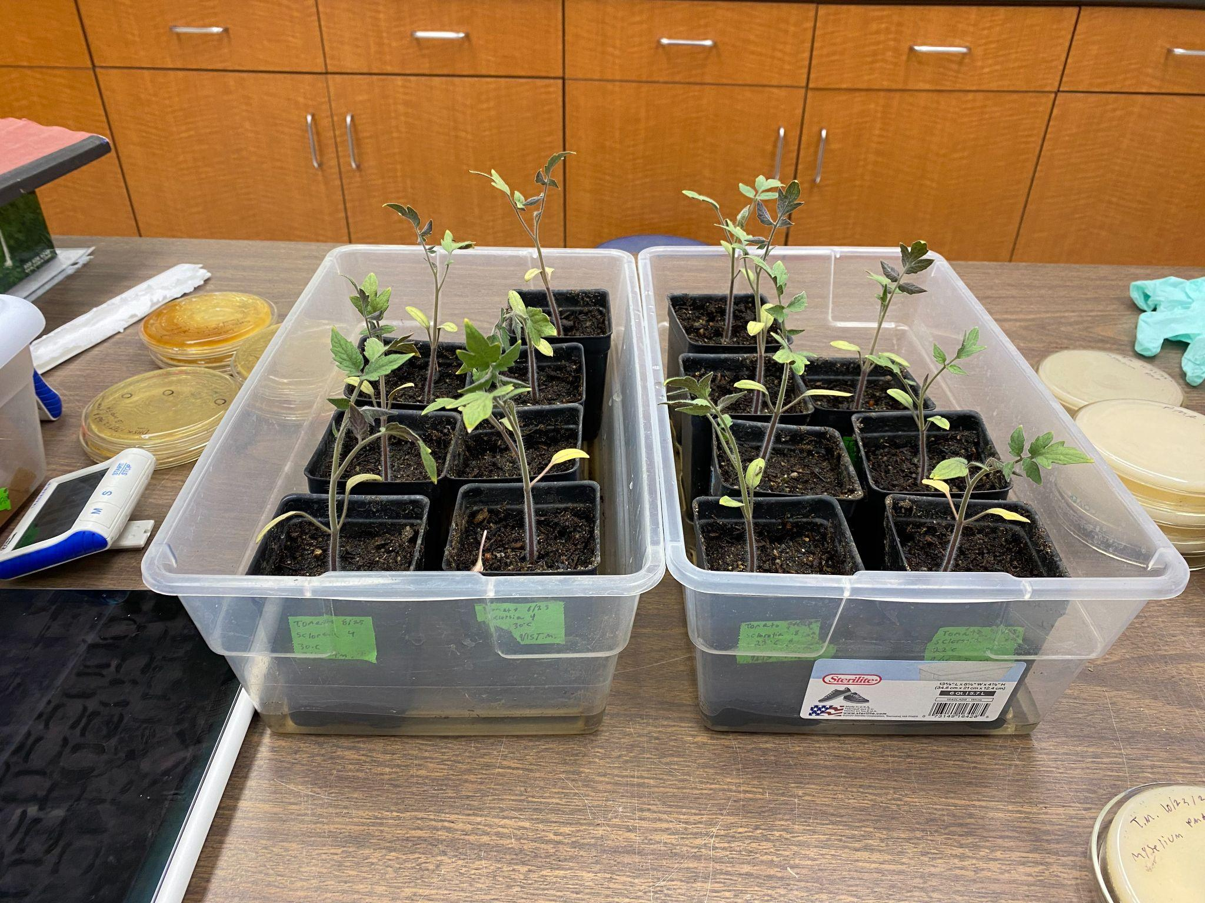
Bioassays

Slide 10
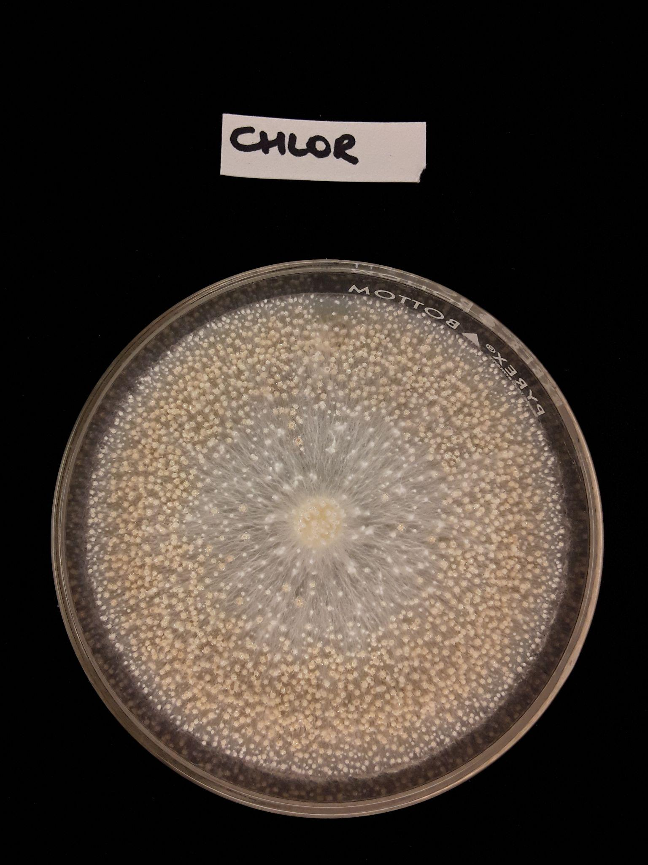
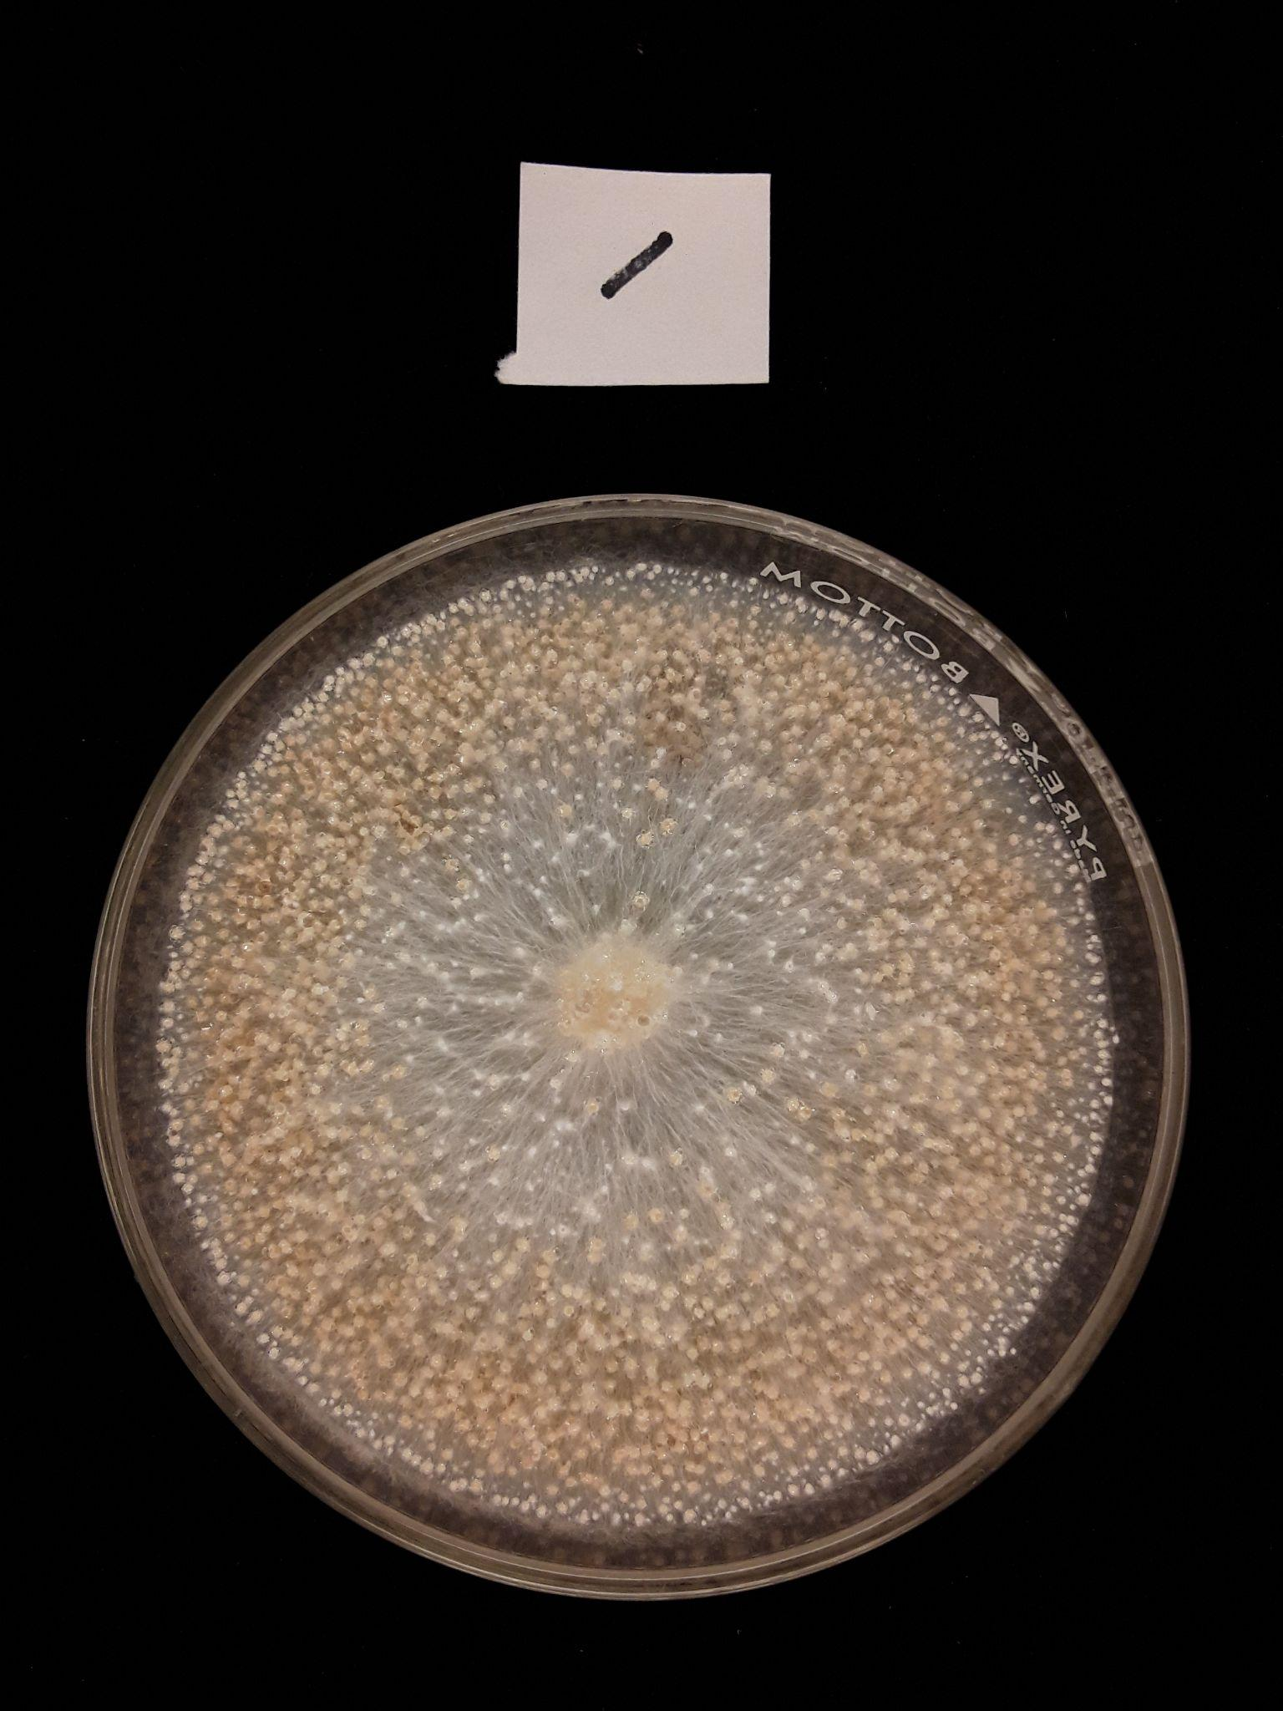
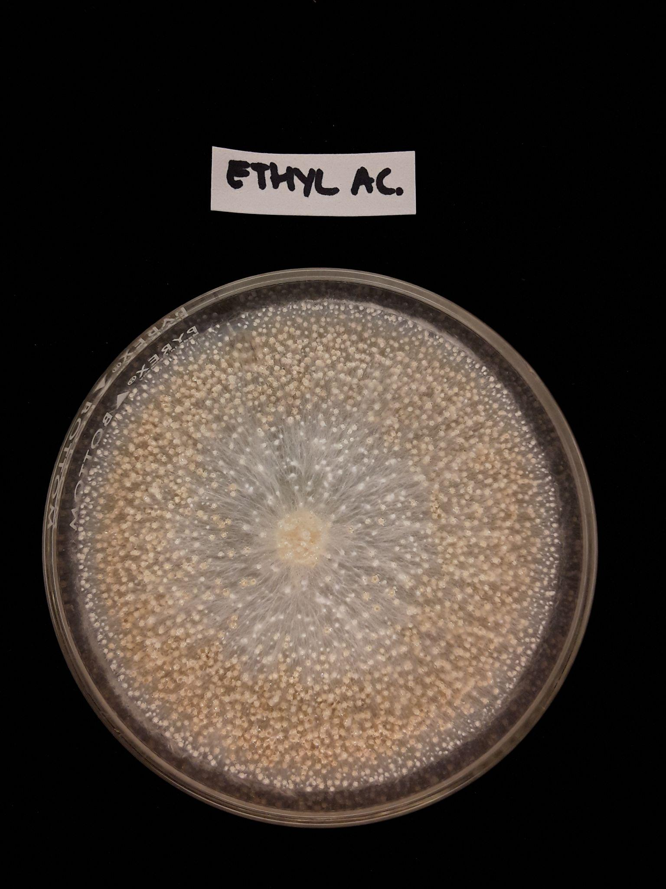
Extractions

Slide 11
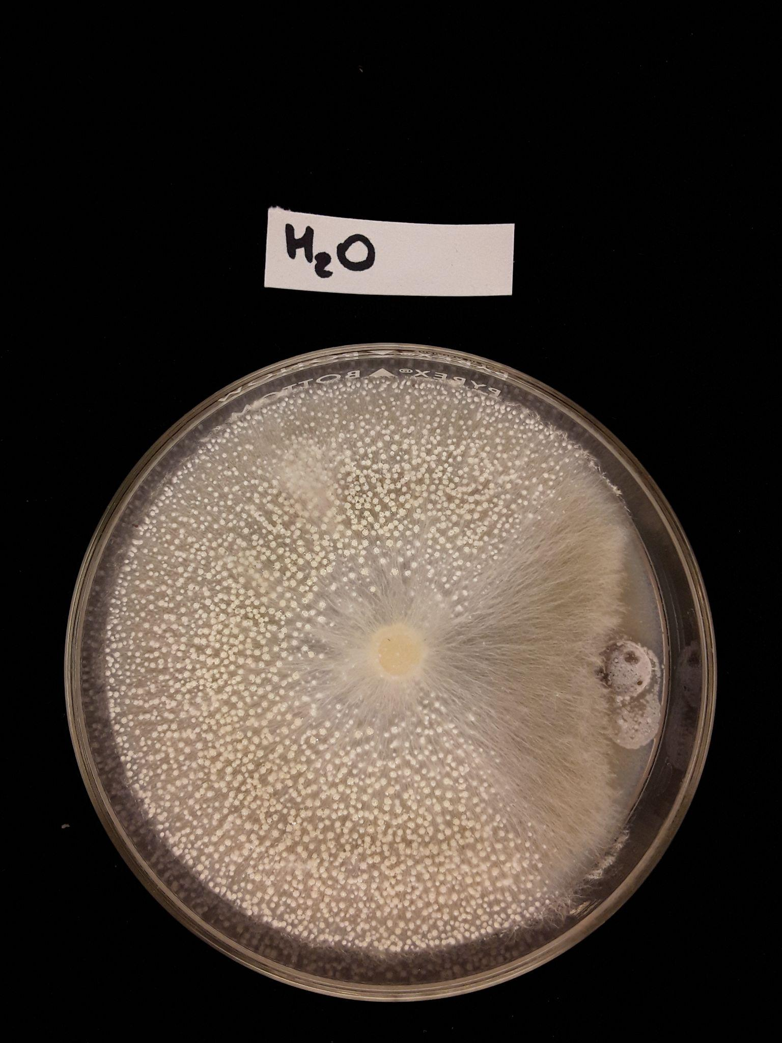
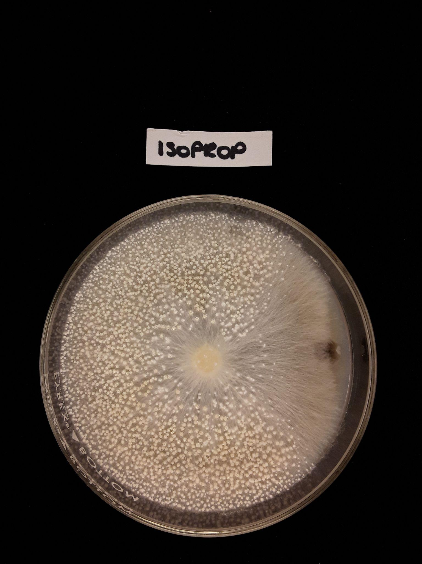
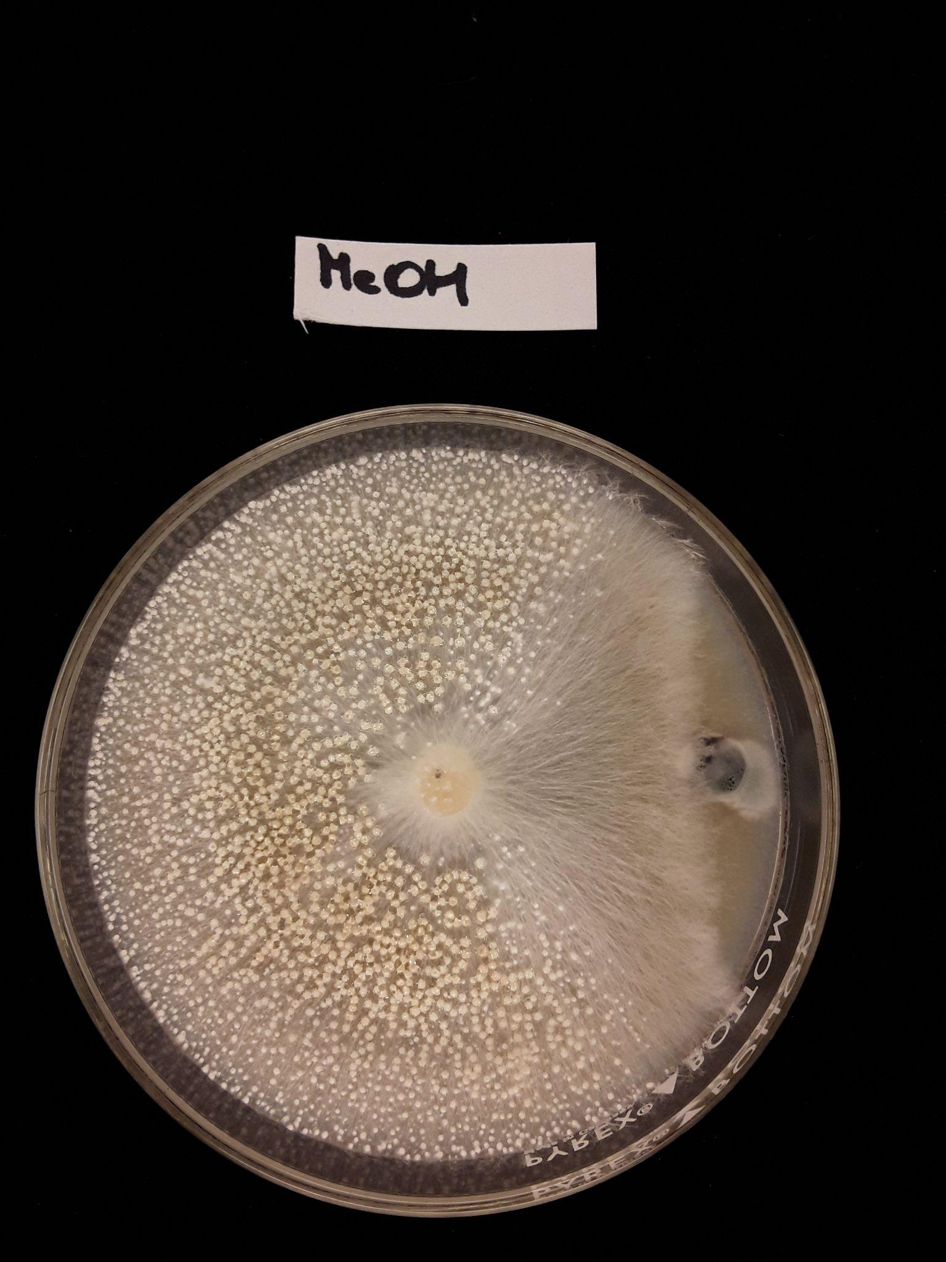
Extractions

Slide 12
What to Change
Create a soil that retains more water
Extractions with and without filter

Slide 13
Not Ready For The Field
No way to administer
To either use GM18-153 or chemicals produced
No successful bioassays
Setbacks with extractions

Slide 14
The Future
Test bioassay with spores and chemical
Use field soil
Test in live field

Slide 15
Acknowledgments
Dr. Isolde Francis
Grimm Family Center for Agricultural Business at CSUB

