Slide 1


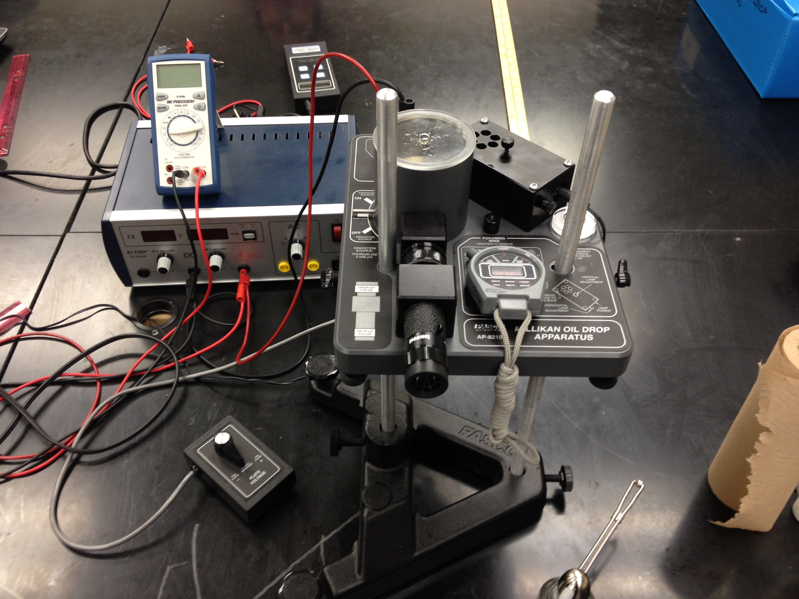
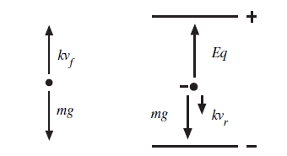
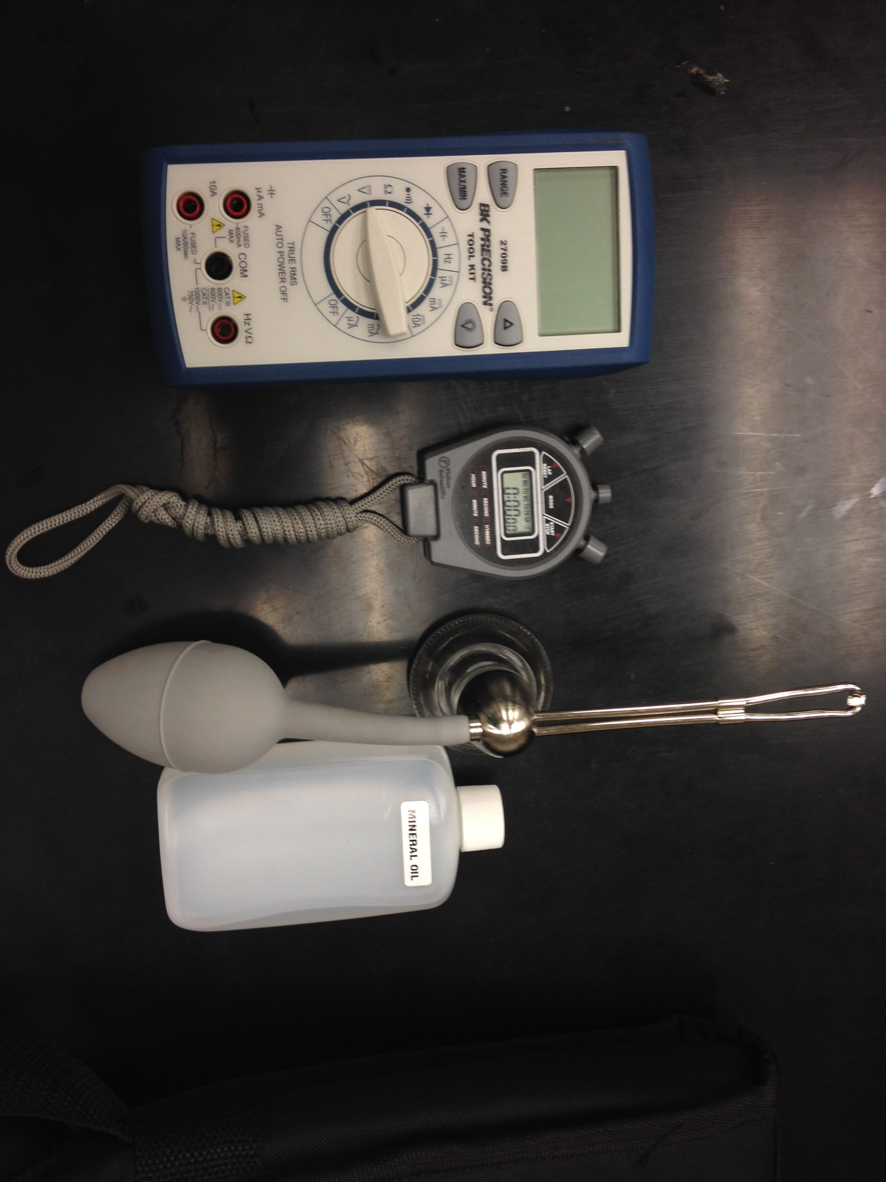

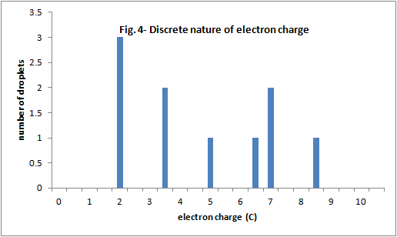
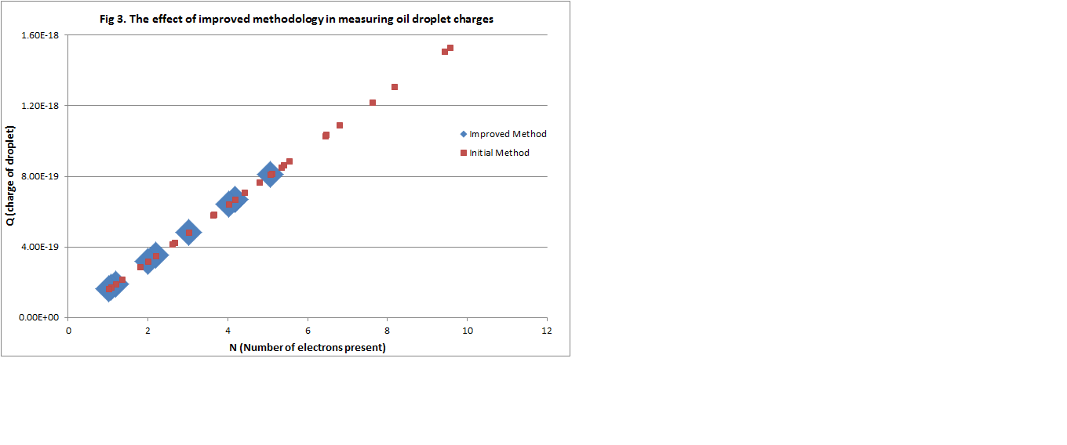
Physics Group: Kian Talaei, Chandler Bartz, Padraic Castillo, Tyler Ferris, Andrew Ramirez, Josh Lofty, Jerod Moore, Michael Medrano
Faculty Advisors: Vladimir Gasparyan, Thomas Meyer
Millikan’t, but we can
AKA- Millikan oil Drop experiment
Objective: In this experiment, we have tried to improve the techniques to measure the speed of electrically charged oil drops in the Earth’s gravitational field and in an electric field. Results on the value for the electron’s charge are presented.
Introduction
Experimental Apparatus
Techniques to Optimize Accuracy
In 1909, Robert A. Millikan demonstrated the discrete nature of the electric charge by performing the famous “oil drop experiment.” The apparatus Millikan used is shown schematically in Fig. 1.
Small oil droplets are sprayed with an atomizer above a pair of metallic plates. The droplets are allowed to fall through a small hole in the upper plate. They are then illuminated by a light beam and observed through a microscope. As an oil drop is falling between the plates, its gravitational weight is balanced by the viscous force of the air, eventually reaching a terminal velocity v_{f}, which can be calculated from the size of the droplet a and the air viscosity η. Once a high voltage is applied to the two plates, an upward electric field can be produced, which causes the oil drop, if it is electrically charged, to rise with the velocity v_{r}. Combining expressions for v_{r} and v_{f}, we derive an equation for the electric charge q of the oil drop.
“
Fig. 2- Equipment
Attach a voltmeter in parallel with the power supply for a more accurate reading of the voltage with even more significant digits.
Turn the lights completely off to make visualizing easier.
Adjust the microscope until the grid is at the highest resolution.
Allow the mineral oil droplets to flow through the tip of the atomizer by spraying it on a paper towel before dispensing the droplets into the chamber.
Once the oil droplets are in the chamber, spend time locating a droplet with a different size and velocity than the droplets surrounding it.
Allocate enough time for the droplet to reach terminal velocity by allowing the drop to reach the lowest measurable section in the grid.
The oil droplets are negatively charged, presumably because of friction as they are sprayed with the atomizer. The droplet charge is typically 20 or more electron charges.
We apply additional positive charges to the oil drop using an ionization source that contains radioactive thorium 232. The thorium ionizes the air, which is allowed to enter the chamber containing the droplets. This lowers the total charge on the droplet when air molecules attach themselves to the droplet.
4.
1.
.
a
e
Fig. 1
3.
c
2.
b
d
High voltage power supply
Plate charging switch
Viewing scope
Atomizer
Droplet viewing chamber housing
Tools that affect the accuracy of our data.
The definitions of the symbols used, in SI units:
q- charge, in coulombs, carried by the droplet
d- separation of the plates in the condenser in m
ρ- density of oil in kg/m³
g- acceleration of gravity in m/s²
η- viscosity of air in poise (Ns/m²)
b- constant, equal to 8.20 x 10⁻³ Pa ∙ m
p- barometric pressure in pascals
a- radius of the drop in m
v_{f}- velocity of fall in m/s
v_{r}- velocity of rise in m/s
V- potential difference across the plates in volts.
Fig. 3- The effect of improved methodology in measuring oil droplet charges
Data and Results
General Procedure
Fig. 3 shows the data for all droplets using the general (small red squares) and improved (large blue squares) procedures. The charge of each droplet is shown as a function of N, the number of electron charges (assuming q_{e} = 1.6 x 10⁻¹⁹ C). In Fig. 4, we show a histogram of the charges q_{i} of all ten droplets measured using the improved procedure only. The assignment of the number N_{i}, the number of electron charges on each droplet, is obvious from the graph. We then compute the electron charge q_{e} = ∑q_{i} / ∑N_{i} = 1.66 x 10⁻¹⁹ C. The accepted value is q_{e}= 1.602 x 10⁻¹⁹ C. Our results show that it is important to make measurements as accurately as possible, i.e. use the most effective techniques. In our case, this meant to optimize measurements for v_{r} and v_{f}.
Clean and set up the equipment shown in Fig. 2 and turn on the power supply.
Spray mineral oil into the chamber.
Use the microscope to locate the tiny, yellow oil droplets.
Measure the time (with a stopwatch) it takes for a droplet to rise, after reaching terminal velocity, between two grid lines (0.5 mm). The electric field is turned on.
With the electric field turned off, follow the same oil droplet and measure the time it takes for the drop to fall between two grid lines.
Follow steps 4 and 5 two more times and average the three times for the rising velocities and falling velocities.
Plug in the average times and constants into the equation to obtain a value for q, the charge of the oil droplet.
References
“The Millikan Oil Drop Experiment.” Regents Prep, n.d. Web. 04 Aug. 2014
Millikan Oil Drop Apparatus Manual. Roseville: PASCO Scientific.

